Slide 1

Community Solar:
Clean Energy for Everyone, Everywhere

Slide 2
Sourcing clean renewable energy like solar is one of the easiest and most meaningful actions that religious institutions and congregants can take to fight climate change.
Renewable Energy and Energy efficiency can achieve over 90 % of the energy-related CO₂ emission reductions needed to meet climate goals (IRENA, 2018)
Reducing energy consumption and/or energy costs means more money for congregations to use on other priorities

Slide 3

NYS: Reforming the Energy Vision (REV)
Cut greenhouse gas emissions 80% by 2050
Make energy more affordable
70% of electricity to come from renewables by 2030*
*Climate Leadership and Community Protection Act
  100% carbon free electricity by 2040
  Economy-wide, net-zero carbon emissions by 2050

Slide 4
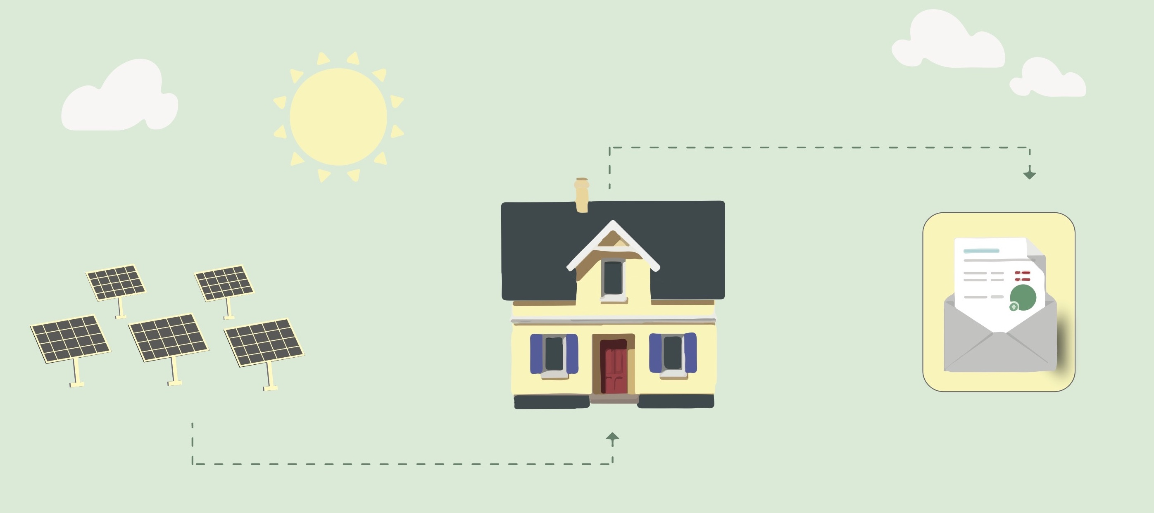
Community Distributed Generation (“CDG”) or “Community Solar”

Slide 5



Benefits
No installation or maintenance
Zero upfront payment
Lower electric bills

Slide 6


RAICA and Ampion/Abundant
RAICA has developed a relationship with Abundant/Ampion and they have agreed to provide the following incentives to promote Community Solar for individuals and institutions of Faith in the Rochester Area
For each new house of worship that signs up using the RAICA promotional code, RAICA will receive a $300 donation that they will share with the house of worship (HoW)
  $150 is donated to HoW through RAICA.
Subscribed Houses of Worship will receive a promotion code and flyer to post from Abundant/Ampion
  For each members that sign up with a HoW promo code, the house of worship receives $50.
  RAICA also receives a $25 donation

Slide 7
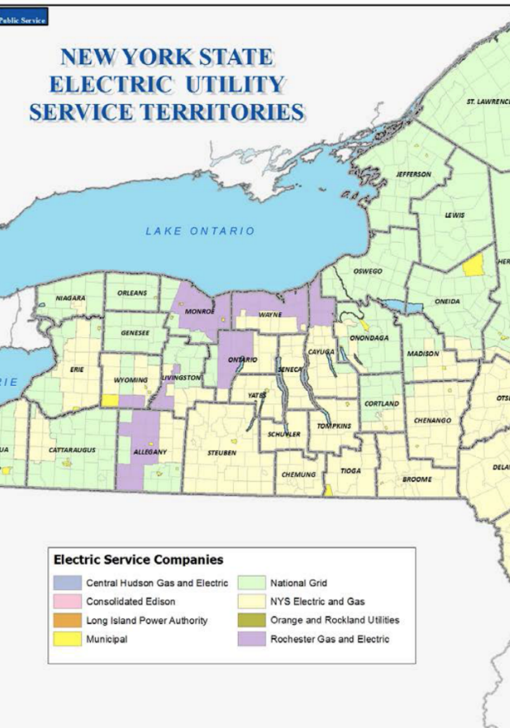
Other community solar projects or providers exist.
We encourage every congregation to check its options for community solar, as contract terms, rates and incentives may vary…
We are aware of the following other projects that we believe are currently accepting subscribers:
RG&E service area:
Astral Power (/Delaware River Solar): https://www.astralpower.com
Arcadia Power (/ForeFront): www.arcadiapower.com/community-solar/new-york/
GreenSpark Solar: https://greensparksolar.com/community/
National Grid service :
Blue Rock Energy: https://bluerockenergy.com/grandislandsolar/
NYSEG service area:
Blue Rock Energy: https://bluerockenergy.com/solarfarm/
…but we encourage every congregation to consider community solar

Slide 8



Ampion
Supporting renewable energy providers with software and administration services
Abundant Energy
Developing, installing, and operating solar projects across North America

Slide 9
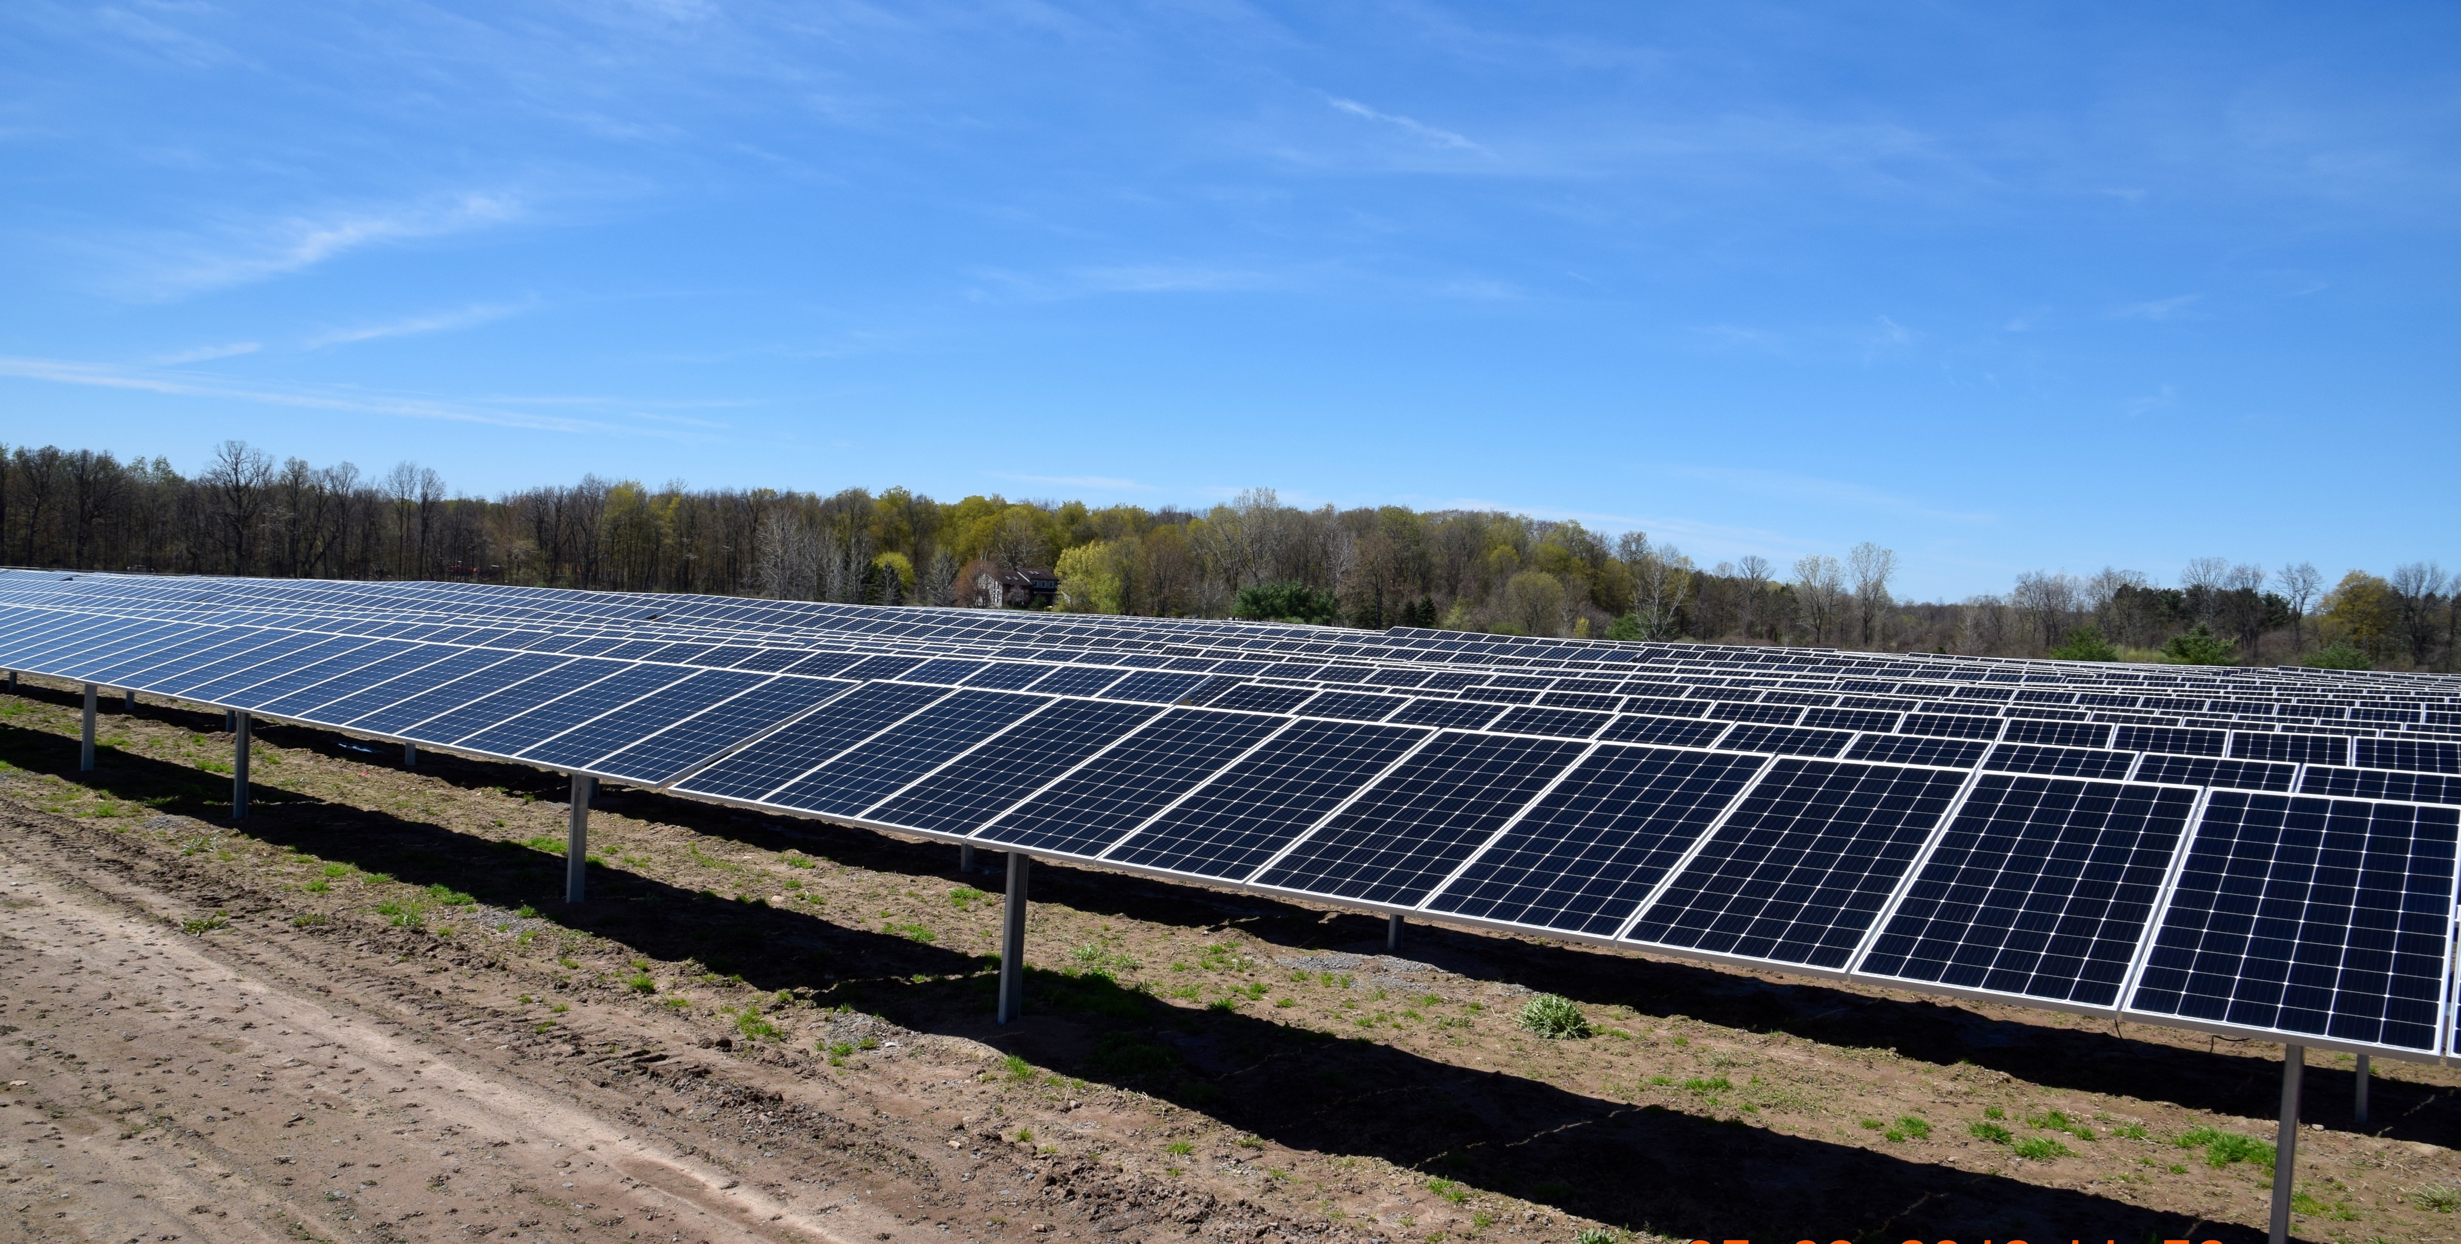

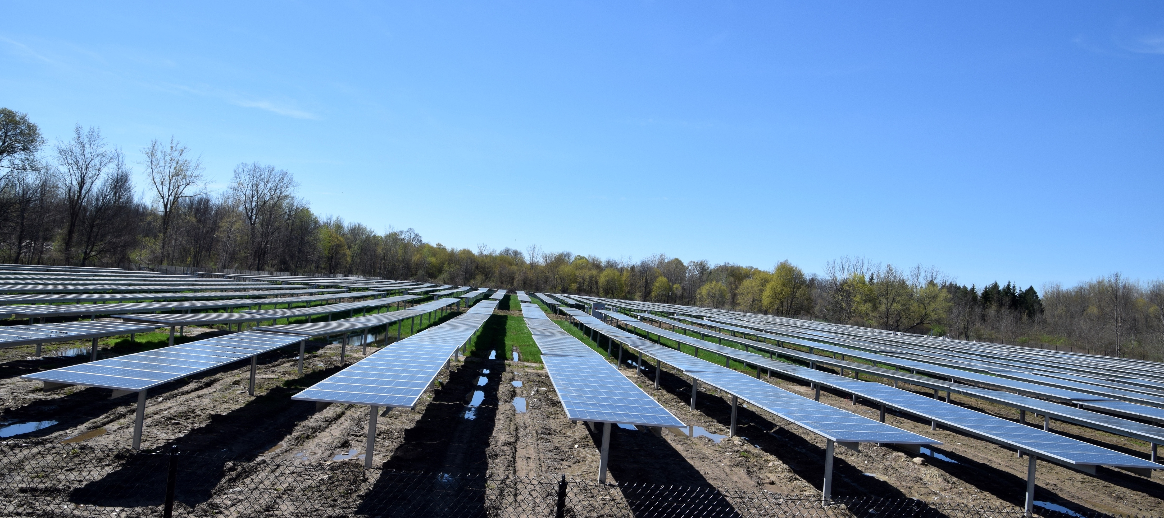

CURRENT PROJECTS
Spencerport
East Bloomfield
Williamson
Macedon

Slide 10

Terms
Requirements
1 year term
No signup or exit fee
90-day cancellation notice
10% discount on credits
Valid RG&E utility account
  SC1, SC2 or SC4
Annual usage >1,000kWh
Payment Details
Contract signature

Slide 11
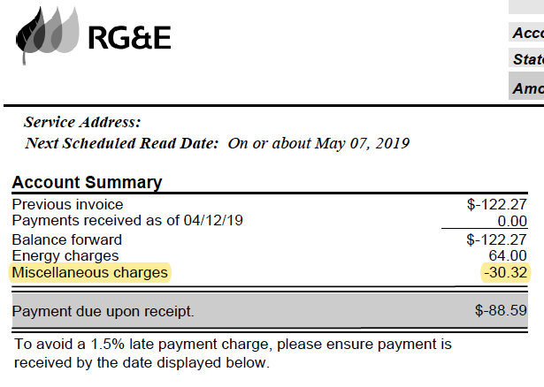
What Your Bill Looks Like

Slide 12
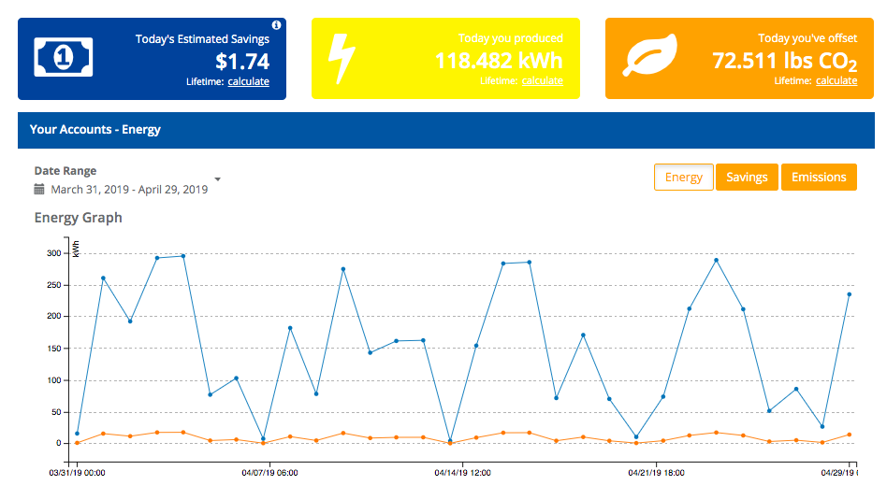
Track Your Impact

Slide 13
How to sign up
Visit www.signup.abundantenergy.ampion.net
For a new house of worship enter the promo code RAICA
For members signing up through a house of worship enter the appropriate promo code for that house of worship
  from their flyer or visit RA https://www.raica.net/communnity-solar-campaign

Slide 14

Help spread the word!
For additional information on community solar or other RAICA initiatives go to www.RAICA.net

Slide 15
ESCOs, CCAs and Community Solar
In order to create a competitive retail market for electricity as part of deregulation, NYS electric customers can choose to purchase their electricity from an alternative supplier also called an Energy Service Company (ESCO).
ESCOs supply your electricity while delivery services remain with your existing Utility provider.
ESCOs can buy and sell on the energy markets in order to provide competitive rates or greener power plans.
Community choice aggregation (CCA) programs allow local governments to procure power on behalf of their residents from an alternative supplier (ESCO). By aggregating demand, communities gain leverage to negotiate better rates or greener power sources.
ESCOs may lower the supply portion of the bill, discounted solar credits reduce the cost of the entire bill. If you’re happy with your ESCO, you might as well do both!

