Slide 1
Greening your Congregation
RAICA Summit
May 19, 2019
Jackie Ebner
Jackie@ResilienceResearchgroup.com

Slide 2
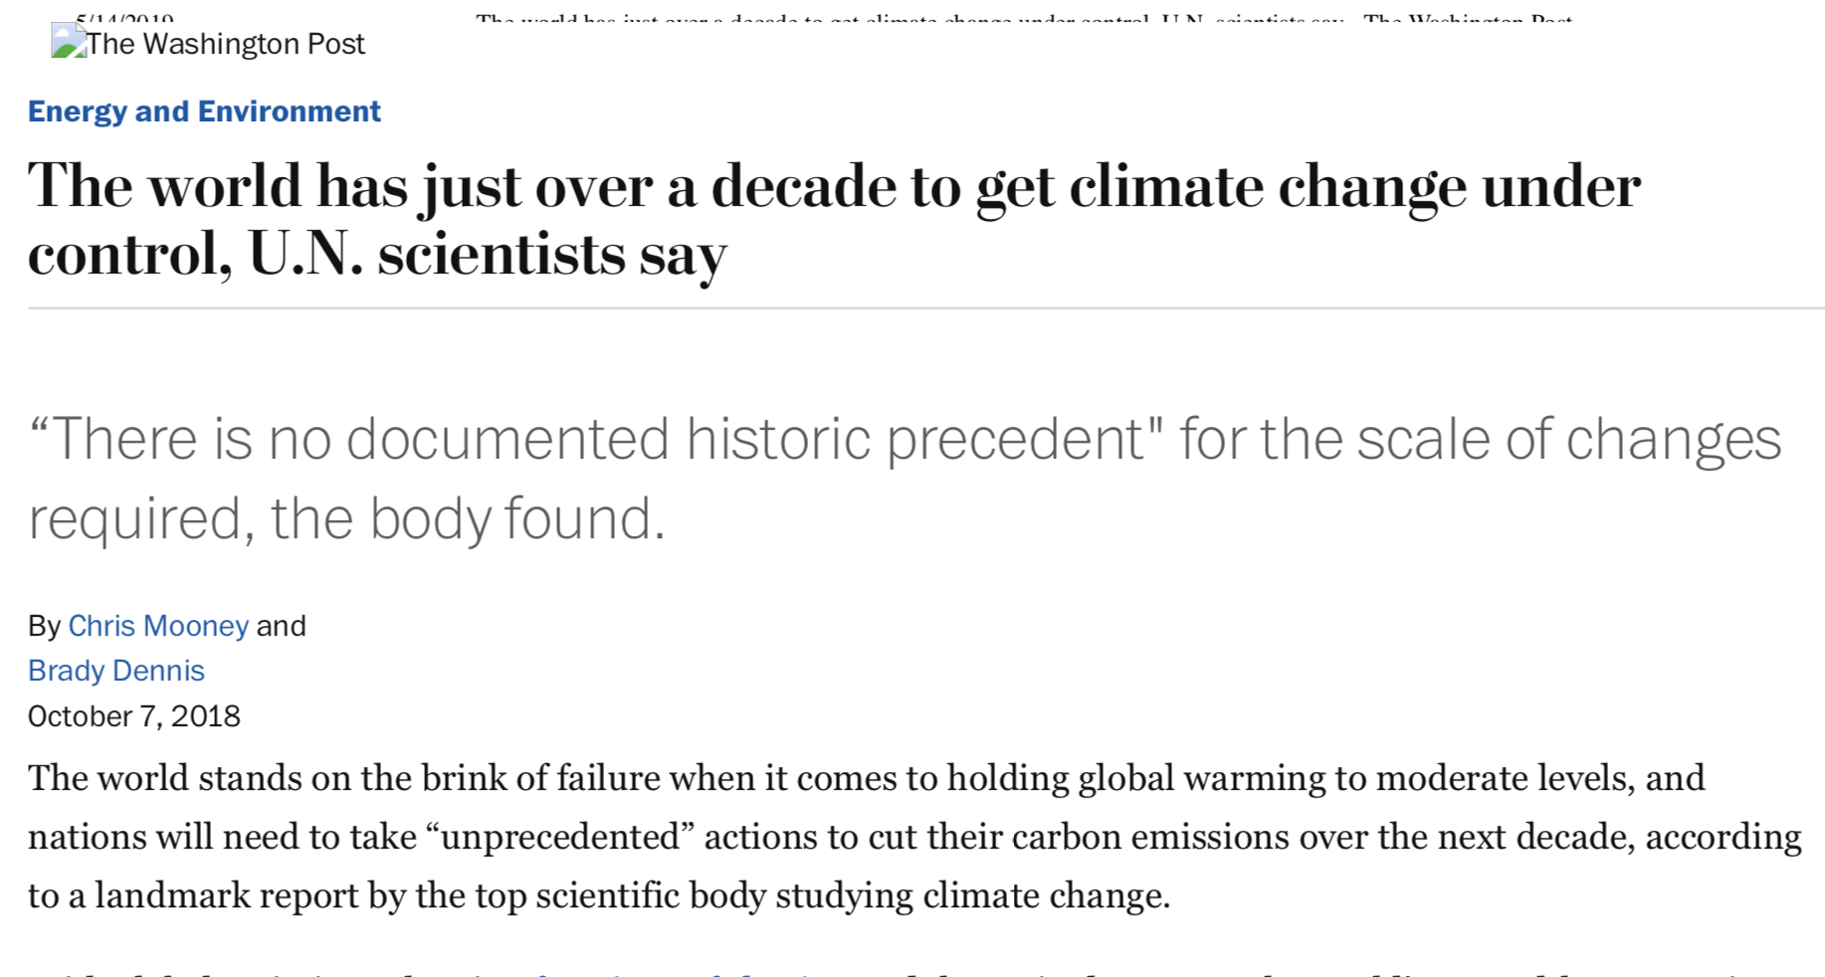
Urgent Action Needed
Notes:
12 years to take action

Slide 3
Eco faith leaders as beacons
An individual’s spheres of influence. Individual actions have the greatest effect when they impact broader systems (Amel, Elise, et al. "Beyond the roots of human inaction: fostering collective effort toward ecosystem conservation." Science 356.6335 (2017): 275-279.
Notes:
Thus it is critical that efforts to overcome individuals’ barriers to change focus not only on motivating them to behave sustainability in their personal sphere, but also on inspiring them to participate in collective efforts to change the larger systems and infrastructure.
rganizations determine the “choice architecture”, or the situational contexts that guide actions and decisions (33). A “green” organizational culture effectively relieves individuals from the effortful thinking required to recognize and respond in sustainable ways. For instance, purchasing policies can prioritize vendors that meet sustainability criteria and technology policies can set machine defaults to efficiency modes. Individuals no longer have to have background knowledge, do research, and evaluate myriad choices for every behavior relevant to sustainability.

Slide 4
How do faith Institutions make and impact
As an influence
Role model /exemplar
Education
Inspiration/Worship
At our facilities
Energy Use
Materials (office/school)
Food
Grounds/Landscaping
Investments
Faith Institutions
As a community
Collective action
Sharing resources
Collaborative action
Social action
Advocacy

Slide 5
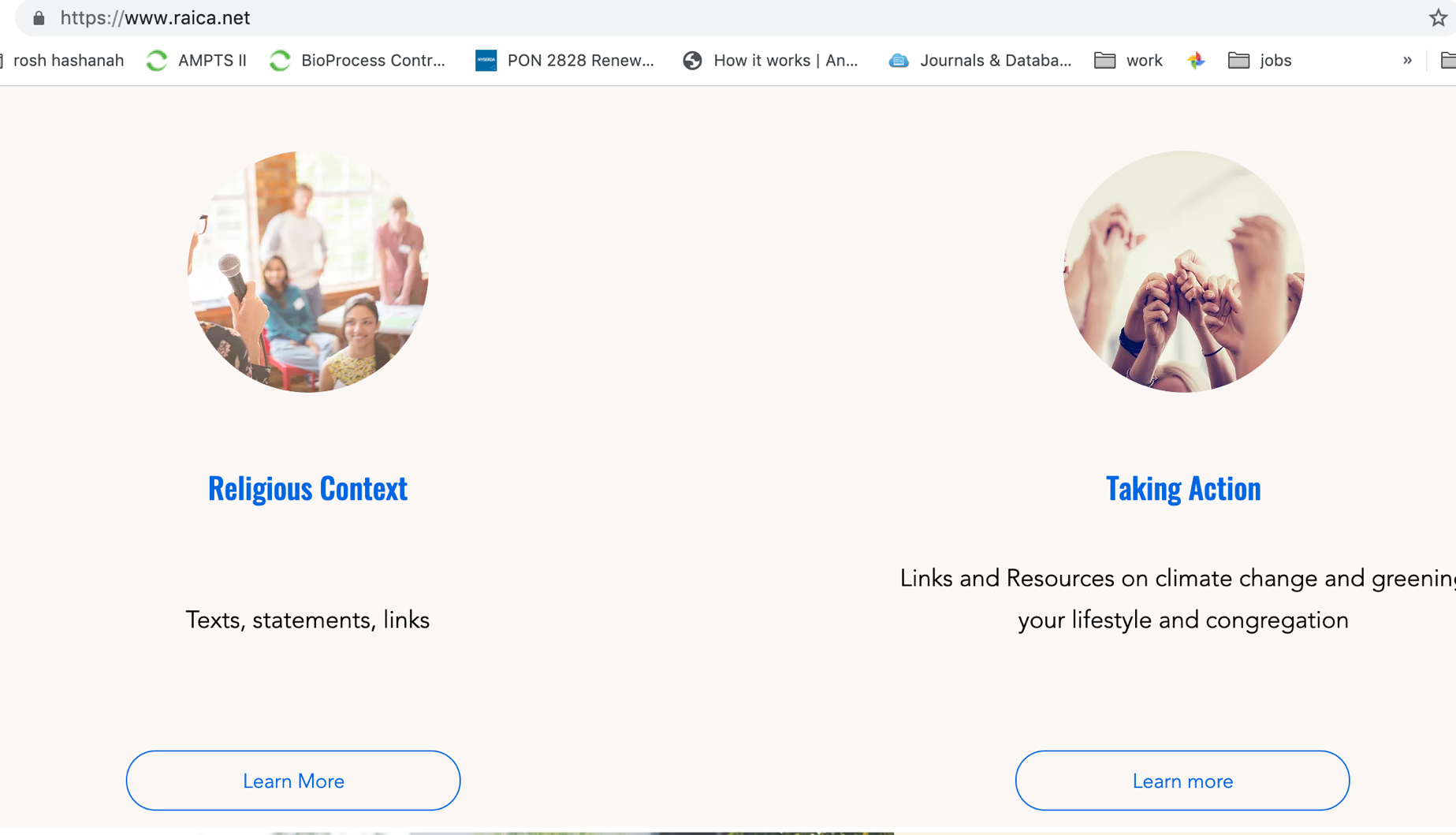
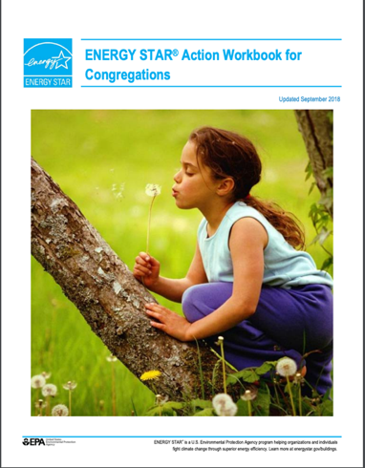
Getting Started
Notes:
EPA workbook- some good guidance for organizing ,energy and facility focused
Green Faith Guide- Washington DC product for faith community- broad areas - has very cursory checklist
Greening Guide- room by room, checklist has ratings

Slide 6
Steps to Green your Congregation
Make a commitment and build a team
Assess performance
Identify and prioritize projects
Implement projects
Evaluate
Celebrate achievements

Slide 7
1. Build a team
Make a commitment and build a team
Notes:
Find like minded folks- could be one or two
Could join RAICA working group

Slide 8
2. Assess performance and set goals
Assess performance and set goals
Take stock of how your congregation does or can impact climate change (or the environment)
Walk through audits
Checklists
Benchmarks

Slide 9
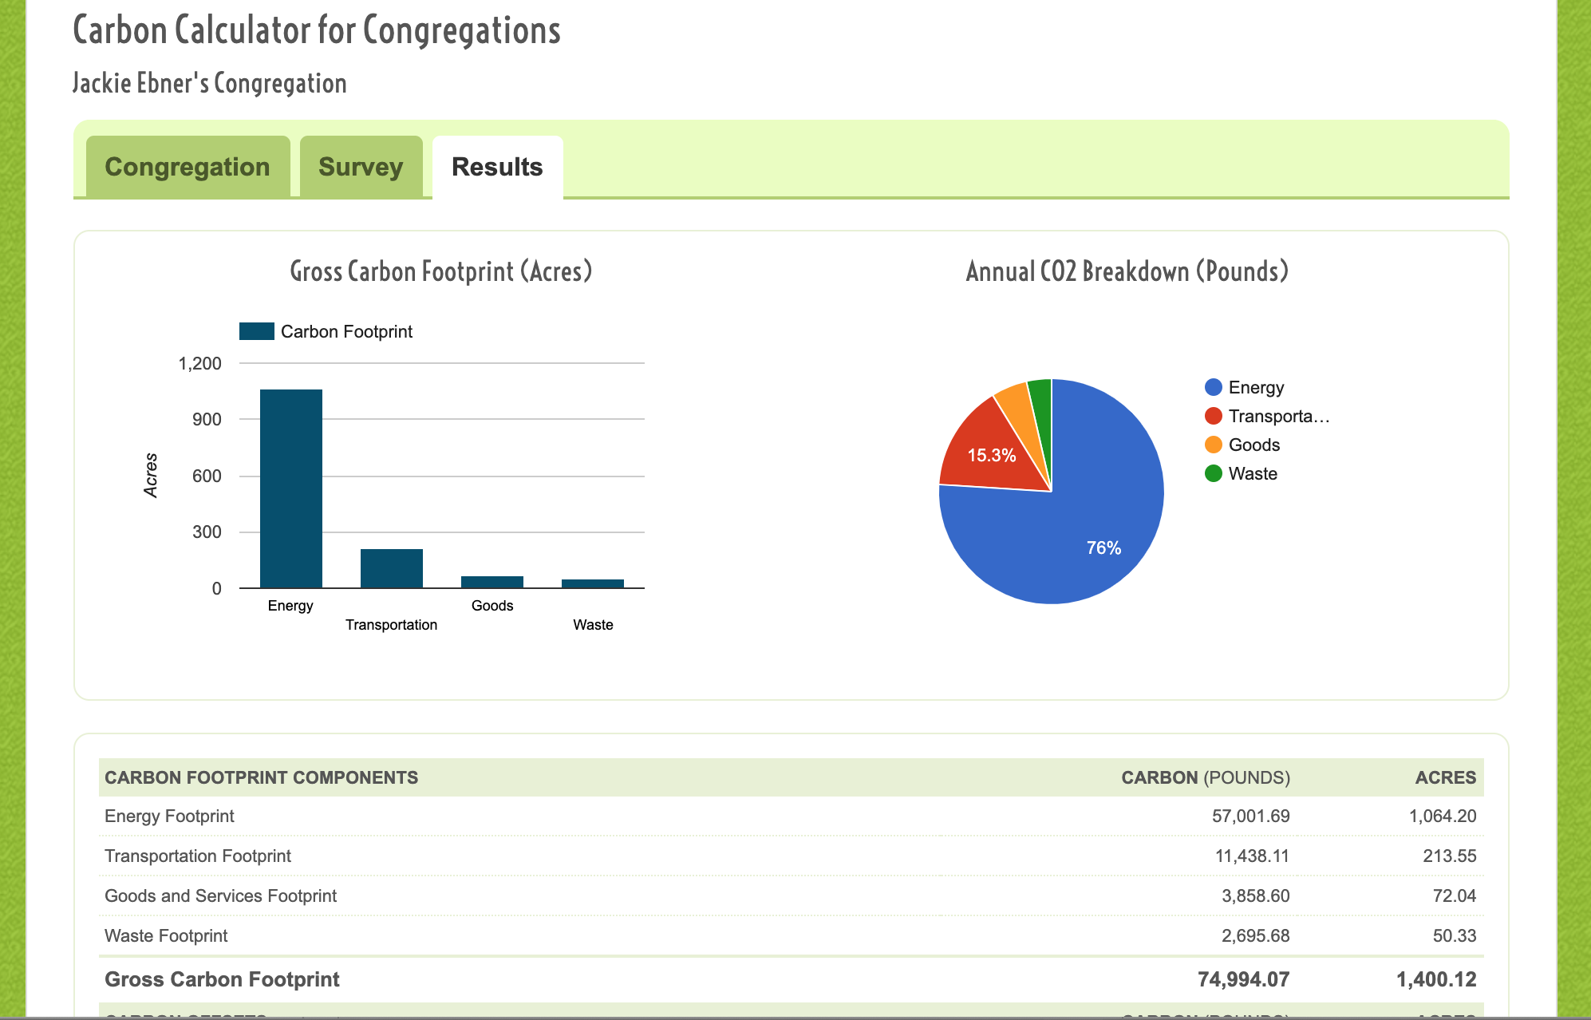
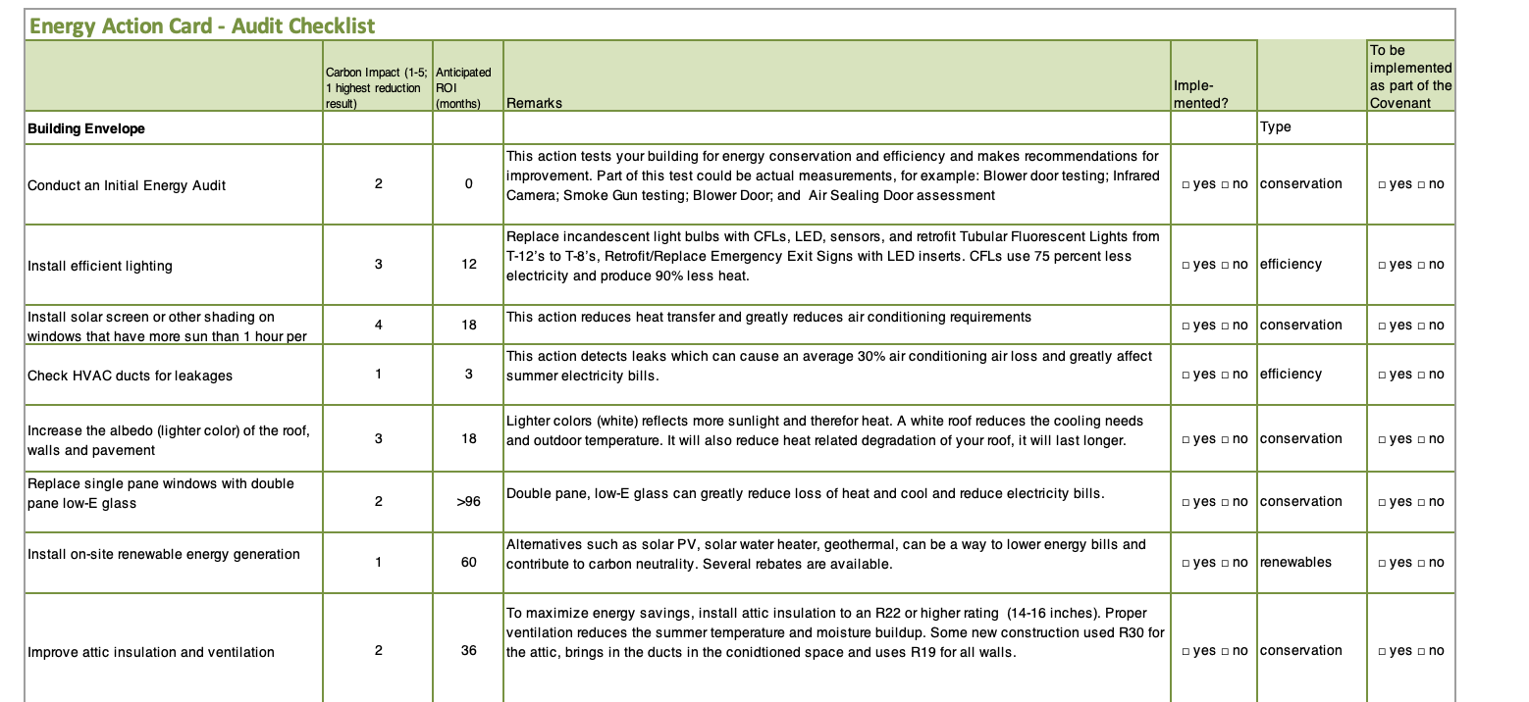
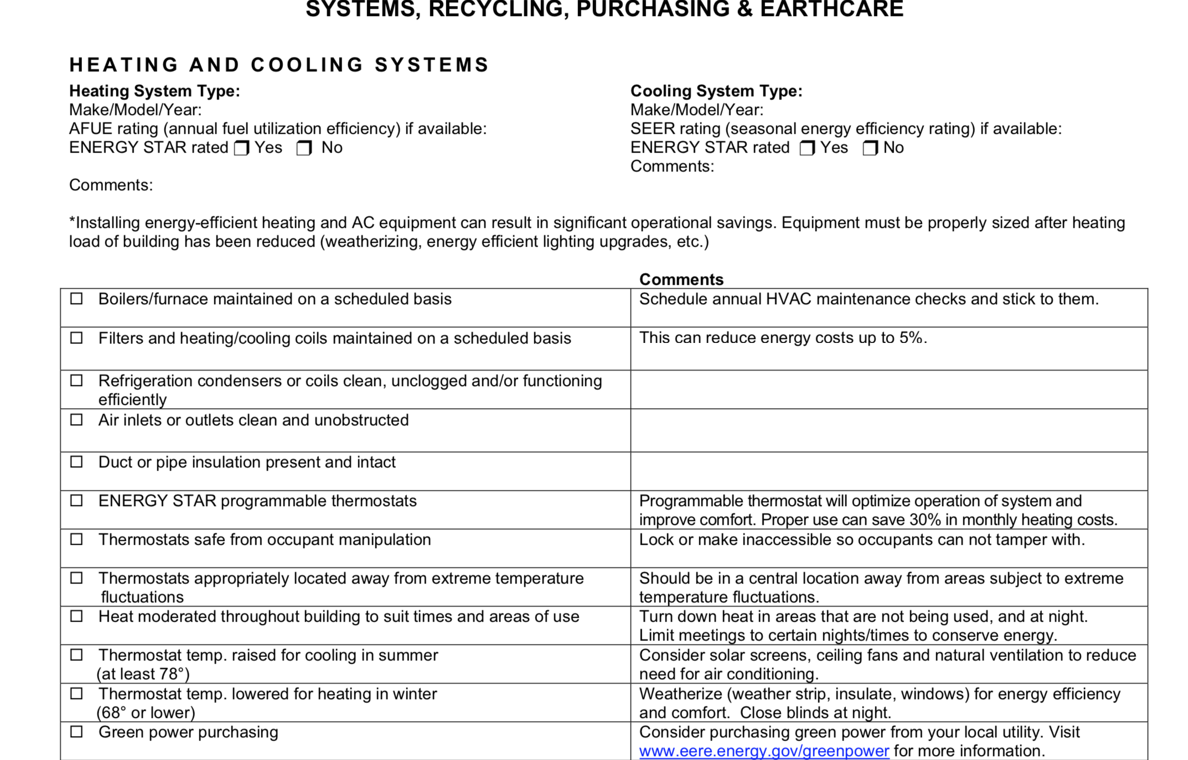
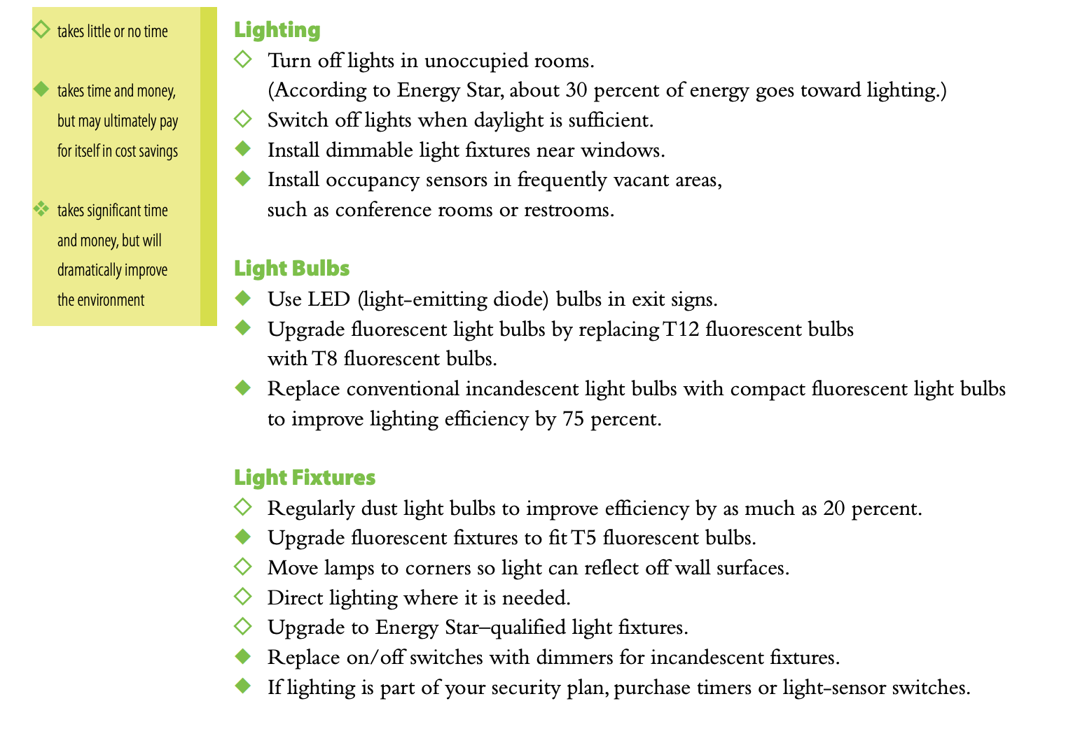
Audits, checklists and benchmarking
Notes:
Mission Investment Fund- Evangelical Lutheran Checklist
UJA Green Guide
Energy Action Checklist-Climate Buddies
Cool Congregations- Carbon Calculator for Congregations- caution does not take into account our region specifically
Also a household calculator
EPAs Portfolio Manager

Slide 10
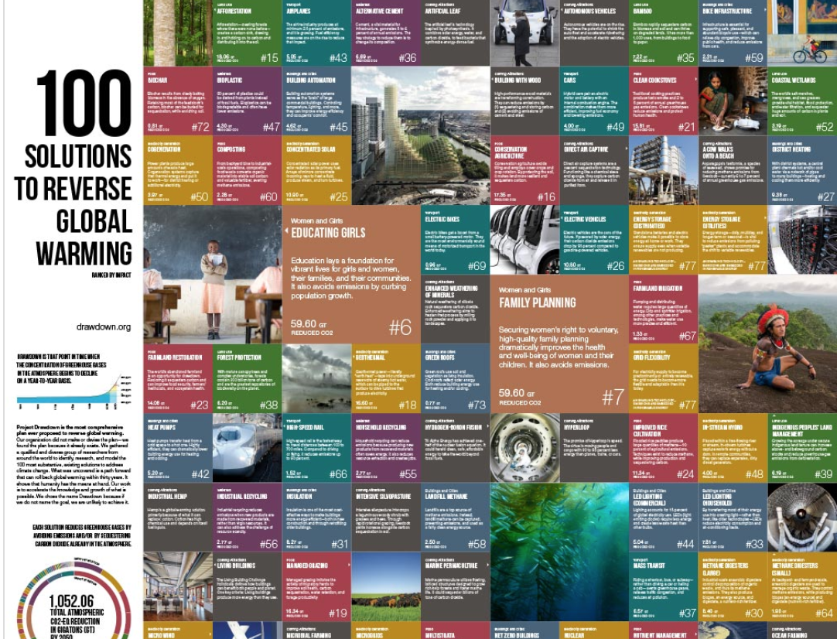
Setting informed goals
Notes:
Recycling is #55 on Project Drawdown list
LED lighting is #44 (Commercial) but easy to do, simple payback etc.

Slide 11
2. Assess performance and set goals
Identify and prioritize projects
What areas are most significant for your congregation
Calculate Return on Investment
EPA Calculators
https://www.energy.gov/eere/femp/energy-and-cost-savings-calculators-energy-efficient-products
Investigate incentives
NYSERDA, RG&E, DSIRE (http://www.dsireusa.org/)
Faith or local grants
Include indirect benefits
Consider
Available resources
Acceptance by the congregation
Alignment with other goals
Which are best to focus on near term vs. long term
Include some easy wins
Notes:
Indirect Benefits- education/modeling- ner tamid, comfort, maintenance (lights), safety (occ sensors)

Slide 12
Implement projects
Plan and implement projects
Determine if In-house, contractor or consultant are the best fit
Consider the size of the projects and skills available in your congregation
Manage maintenance and track project progress
Who will make sure it gets done
Keep records of everything

Slide 13
Celebrate achievements
Share with congregation
Newsletter
Pulpit
Awards/Certifications
Green Congregations Faith recognition, EPA, etc.
Publicize
Social Media
RAICA website
Notes:
Stewardship as a value and are responsibly stewarding their resources
Most faiths have awards
Attract and engage congregants

Slide 14
Main impact areas
Energy efficiency and generation
Transportation
Food and food waste
Waste reduction and recycling
Landscape & Gardens
Outreach, Education and Worship
Advocacy
Others (Social action,socially responsible investing, etc.)
Notes:
Electricity Generation, Food, Women and Girls, Buildings and Cities, Land Use, Transport, Materials
Can be other areas like ethical investing
Women and girls (education, family planning, women stakeholders)- 105 Gigatons more than wind and solar combined!

Slide 15
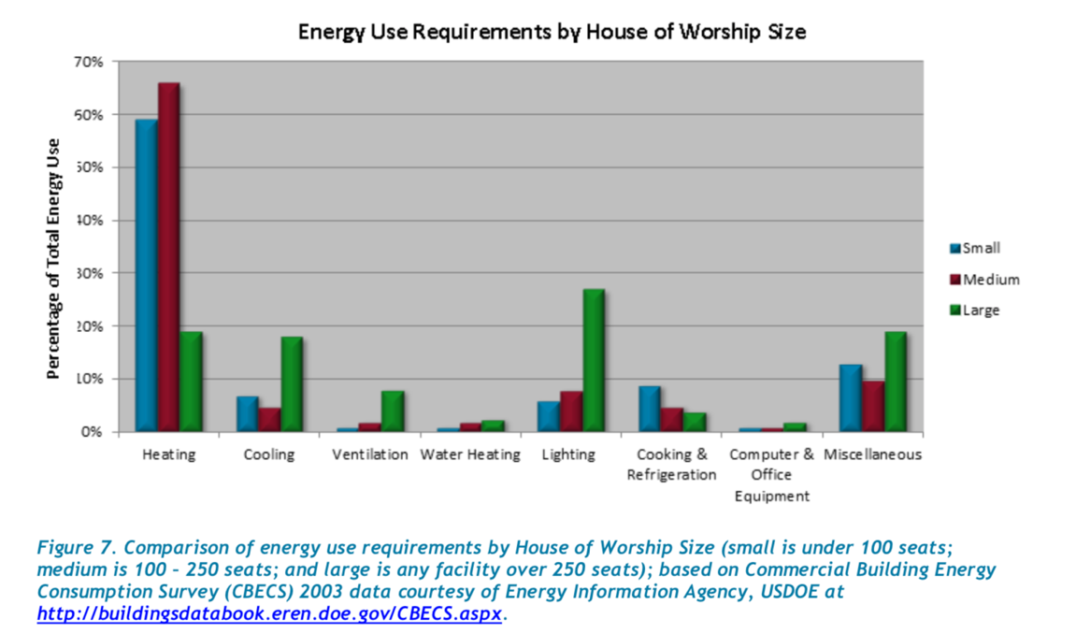
Energy Efficiency
Electricity, Heating and Cooling make up about 48% of the NYS GHG inventory (NYSERDA,2015)
The median congregation uses about 2,000 mmbtu (annually)
more than 20X the average household –although wide variation
For a congregation with an annual energy bill of $30,000
A 30% reduction is $9,000
Energy efficiency improvements are often linked to other benefits (i.e. comfort, safety, maint., etc.)

Slide 16
Energy Efficiency
Things congregations are doing:
Lighting- daylighting, T5 CFLs, LED exit signs, occupancy sensors, etc.
HVAC- thermostat setting, hot water heater settings, maintenance, building occupancy optimization, ceiling fans, windows, insulation, etc.
Appliances- unplug electronics, power strip, sleep setting, Energy Star Appliances, refrigerator coils,

Slide 17
Professional Energy Efficiency Audit
Notes:
See Scott Oliver from Pathstone

Slide 18
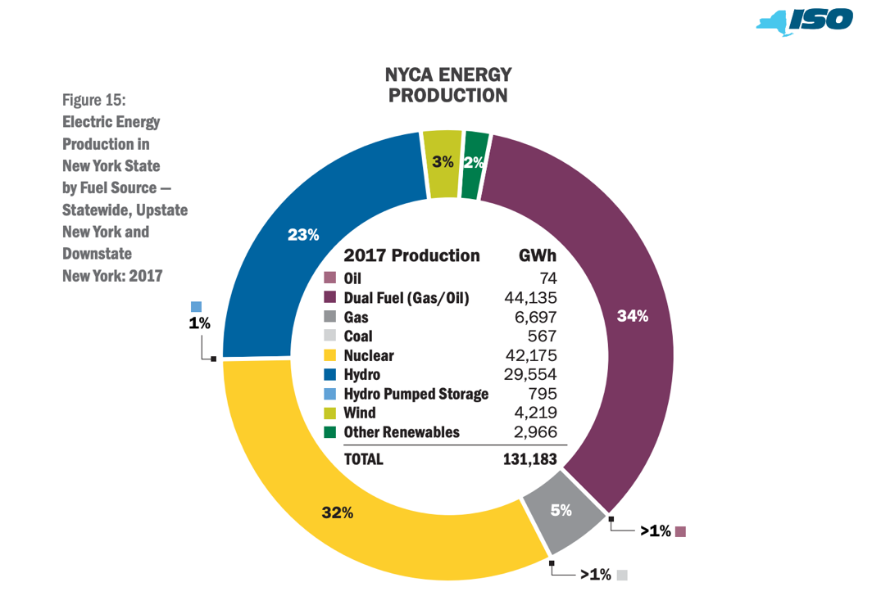
Energy Generation
Renewable Energy and Energy efficiency can achieve over 90 % of the energy-related CO2 emission reductions needed to meet climate goals (IRENA, 2018)
Commercially available technologies, could adequately supply 80% of total U.S. generation in 2050 while balancing supply/d demand. (NREL, RE Futures, 2012)
NY grid mix is low carbon (especially upstate generation (92%)) and the potential for more renewables is high
PSC directive 50% by 2030 (Gov .proposal 100% by 2040)
Today wind and solar 4%- 29,200 GWh of renewable energy will need to be added 2030 to achieve 50/30
NYISO Power Trends 2018
Notes:
We will close our last coal plants (dropped from 11% (2000) to 2.5% (2018), Wind went from 0 to 4.5.%
This is electricity- so need to shift to it- transportation and heating!!
50 by 30
Consumption lower than national average per person but higher than generationNY imports from Canada and neighboring states

Slide 19
Energy Generation
Things congregations are doing:
Onsite Renewable energy
Community Solar (Abundant, BlueRock, GreenSpark)
“Go electric” (RPCC)- Heat pumps, vehicles
Carbon Offsets
Retail Choice (Community Choice Aggregation)
Advocacy. (CCL and 100% renewable by 2040)
Notes:
Green New deal- large scale renewables, green job accelerator, 100% renewables.

Slide 20
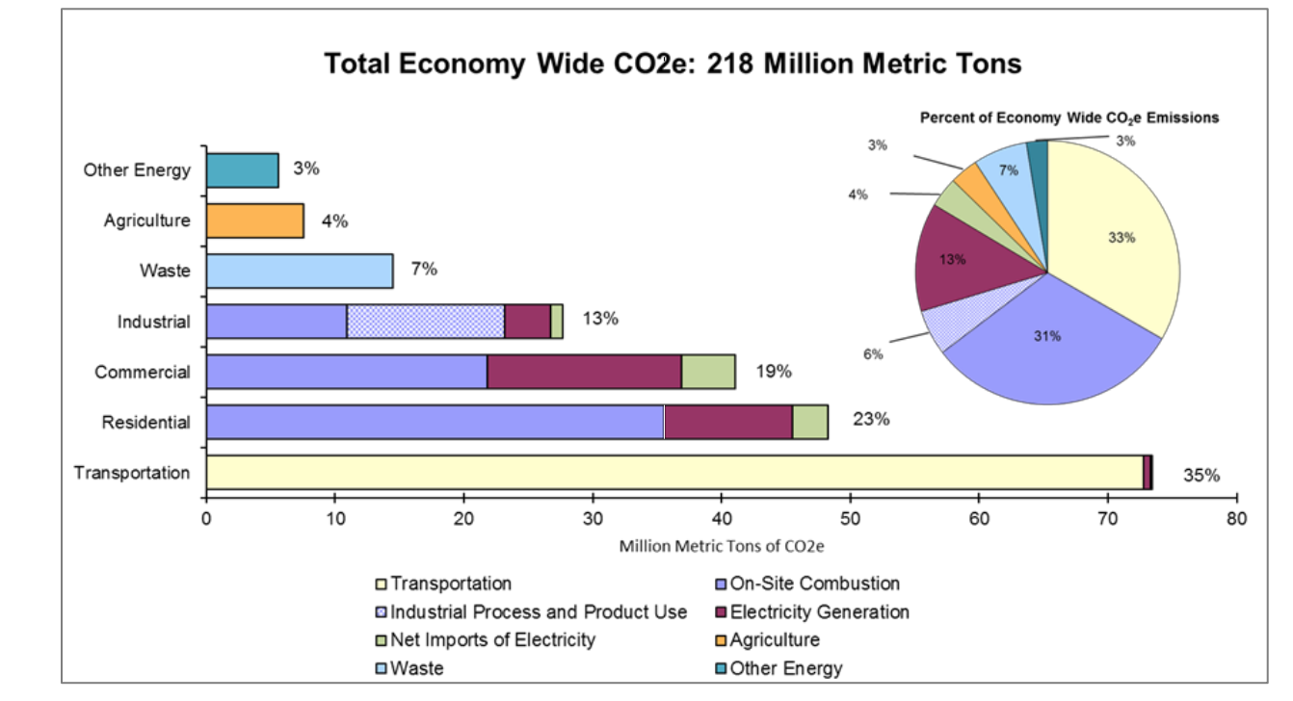
Transportation
Transportation is the largest component of NYS emissions and the largest contribution for most individuals
Transportation emissions for congregants can be 20%-50% of congregation GHG inventory
NYS GHG Inventory: 1990-2015, (2018)
Notes:
EPA ghg emissions
We have lots of effort underway to green our electricity but not much to drive transporatation emissions.

Slide 21
Transportation
Things congregations are doing
Carpooling
No Idling Zones
Bike Racks
“No drive Sabbath” and other campaigns
Electric Vehicle campaign (bulk purchases)
Charging stations
Carbon offsets for air travel
Advocate for low carbon fuel standards, mass transit and bike/walk-ability (ReImagine RTS)

Slide 22
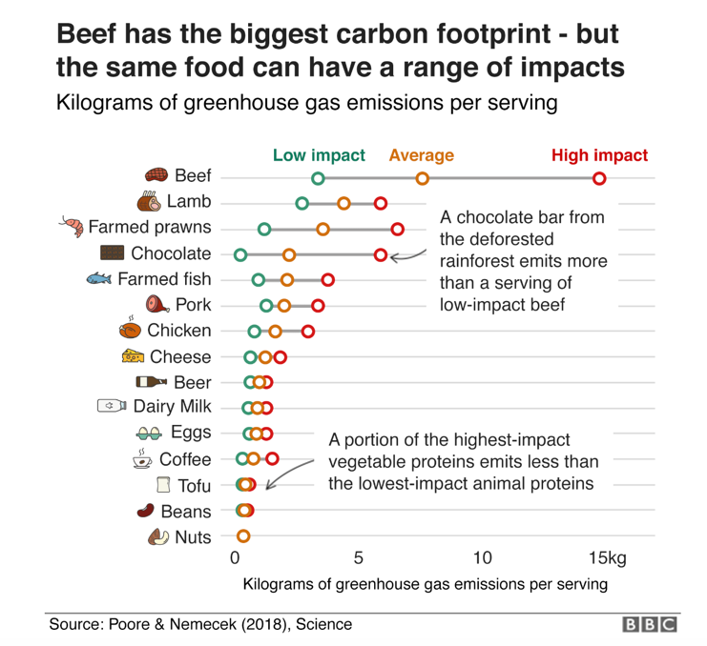
Food and Food waste
Food system emissions contribute 19%—29% of global GHG emissions (USEPA, 2011)
Livestock alone is 14.5%
30%-40% of food is not consumed or wasted
Most food waste in developed countries occurs at the retail and consumer level
Food waste is the largest single material in our everyday trash, constituting 22% of discarded MSW.
In a landfill Food Waste rapidly decays creating methane (28X more powerful than CO2) and some Nitrous oxide (310X more powerful)

Slide 23
Food and food waste
Things congregations are doing
Measuring food waste
Participate in Wasted Food Weekend: September 6-8, 2019.
http://foodwasteweekend.org/
Rescuing unserved food
Foodlink
Composting/Anaerobic Digestion
Cornell Cooperative Extension, Community Compost, Impact Earth
Advocate for collection and regulation
Notes:
NYS Food Donation and Food Scrap Recycling Act (2019-2020) budget

Slide 24
Waste reduction, reuse and recycling
Among industrialized nations, the United States generates the largest amount of municipal solid waste per person on a daily basis, about 4.5lbs/person/day (OECD, 2015)
Reducing our consumption reduces reduces the raw materials, energy, transportation and disposal impacts of these goods
US recycling rate is about 37%
High quality paper and metals have the largest impact
Although the impact of waste reduction and recycling on climate change in indirect, there are many other environmental impacts (e.g. ocean pollution, land use, toxicity, etc.)
Notes:
EPA ghg emissions
We have lots of effort underway to green our electricity but not much to drive transporatation emissions.

Slide 25
Waste Reduction, Reuse and Recycling
Things congregations are doing
Buy less
Clothing donation
Materials exchanges or swaps
2-sided printing
Using scraps and waste materials for crafts
Clear signs and adequate bins for Recycling
Buy recycled!
Legislation - plastics

Slide 26
Landscape and Gardening
Things Congregations are doing:
Native plants, hedges and understory planting to reduce mowing
Community Gardens
Green landscaping
Permeable pavement
Green roofs
Notes:
Soil has the ability to sequester carbon
Land use change can have a significant impact
Water runoff,

Slide 27
Education, Worship and Advocacy
Things congregations are doing:
Youth and Education programming
RAICA.net/tools and resources (curriculum)
Sermons and holidays
RAICA.net /tools and resources/(religious texts)
Coordinated outreach
Coordinated political campaigns
CCL, RPCC, etc.
Call your representative
Social media

Slide 28
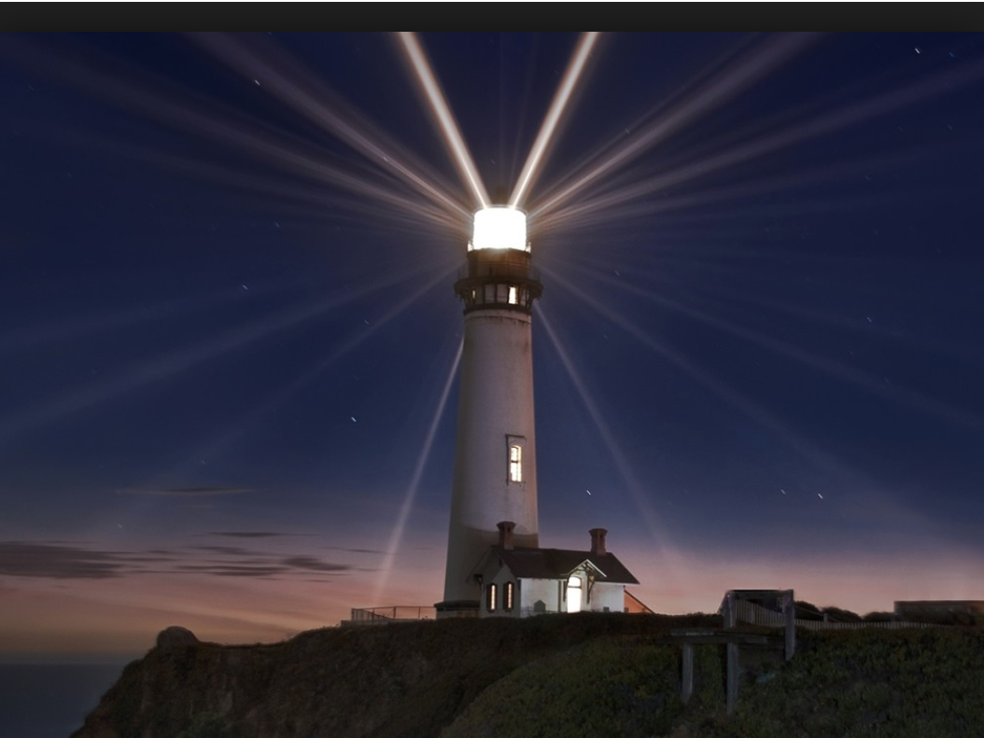
Be a beacon
Think big!
Start small and build upon successes
Create new normal for your community
Mobilize

