Slide 1


Reversing Global Warming
Introduction to Drawdown
Notes:
3 min.
What a joy it is to be with you all here today, looking at the reality of our times – and the path forward together!
The news daily tells us about the magnitude and urgency of our problem (Crisis) which can often lead to hopelessness and doubt that one person can do anything to address the enormity of it all.
My part now, though, is to move us into a more hopeful perspective, focusing on SOLUTIONS!
I am a volunteer with an organization called the Pachamama Alliance. (the word Pachamama is the indigenous word meaning mother earth – though really means all of life – earth, sky, all species.)
The mission of the PA is to help create a world that is environmentally sustainable, spiritually fulfilling and socially just. It is grounded in the understanding that we are all connected – to each other, to all species, to the earth and to all life.
Project Drawdown (which we will be discussing at length in the short time I have here) is focused on a scientifically based plan to reverse global warming, and offered in a book edited by Paul Hawken – The Most Comprehensive Plan Ever Proposed to Reverse Global Warming (hold up the book!). The 100 solutions they have identified address the energy we use, the food we eat, the cities we live in, and much more. Tonight you will see how the Drawdown plan offers accessible possibilities for us as individuals and collectively to play an active part in reversing GW.
The Pachamama Alliance is partnering with Project DD to make the book accessible to ordinary people – and to inspire people and communities around the world to work together on these solutions.
The PA is active in over 80 countries all over the world, and the Drawdown Initiatives are already growing in Japan , Australia, Romania, England, Mexico, Columbia, and many more countries – as well as many many cities in the US! This really is a movement that is spreading across the globe!
We created 2 programs –
1-session experience (Reversing GW: Introduction to DD) to introduce people to the idea that there is a very real possibility that global warming can be reversed and that you have an important role to play in that process
2) a 4-session workshop/course called Drawdown Solutions – getting into action.
Today you will be experiencing a 40 min very brief taste of the 2 hour Intro to DD.
Today I am going to share with you today a brief overview of Project Drawdown, a well-researched plan to actually reverse global warming.
Handouts – Sectors/Solutions, Ways to Connect with PA
Videos – PH Segment 1, 5 reasons to be optimistic

Slide 2
Becoming
Present…
Notes:
(1 min)
Before we begin, we’re going to take a moment to connect with our own hearts – and the reason we’re here tonight – our love for others, the earth and all life. We’re here because we care.
The Pachamama Alliance is grounded in our partnership with the indigenous people of the Amazon rainforest – and their practice, before any gathering , is to acknowledge and connect in gratitude with the earth and all life that sustains them.
Close your eyes, if you’re comfortable doing that, and take a couple of deep breaths. Notice each inhale and exhale, which we so often take for granted. Allow yourself to feel your body on the chair, your feet on the floor. Appreciate the gravity that connects you to the earth which holds us all – and unites us as living beings. We invite you to rest in the gift of this time, the gift of each other, and the gift of the beautiful earth that sustains us and all life! May we be instruments of healing in the brokenness of all aspects of our world and life together. We live in gratitude and openness to the gift of this time ………(Short pause). Please take another deep breath and open your eyes. Thank you.

Slide 3
Drawdown:
The point in time when the concentration of greenhouse gases in the atmosphere peaks and begins to decline on a year to year basis.
Notes:
2 min
So what is Drawdown? Read slide. Give image of usual emissions charts (always going up) and how DD is turning it around – really REVERSING the direction.
About 2012, as Bill McKibben came out with a very dire report on global warming with its effects of destructive climate change, Paul Hawken was overwhelmed and asked 2 questions: Is it too late? (charts of emissions going ever upward) and What should we be doing about it? He looked and no one had ever scientifically answered those questions. So he gathered a team of 200 scientists to do the research to answer those questions. This was the birth of Project Drawdown. Over a 5 year process they came up with answers. Yes, it is scientifically possible to reverse global warming, and they identified the top 80 solutions that, if upscaled over 30 years, could reverse global warming by 2050. These are currently existing technologies and practices.
Tonight we will begin to look at the comprehensive plan Project Drawdown offers to reverse global warming, and begin to see how we might engage in this work.
The key thing to see is that every solution contributes benefits toward the sustainable, just, overall healthy world we want, and that WE EACH have an important part to play!
Just as getting to the moon was our civilizational goal in the 1960s, reaching Drawdown is the goal of our times – to reverse global warming.
We offered this analogy and someone improved upon it – suggesting that this is really more about the mobilization effort in WWII. Reaching the moon was more focused on the work of NASA, while the WWII mobilization involved everyone! Rationing, sacrificing, everyone contributing to the effort in a variety of ways! That’s what’s needed in these times!

Slide 4
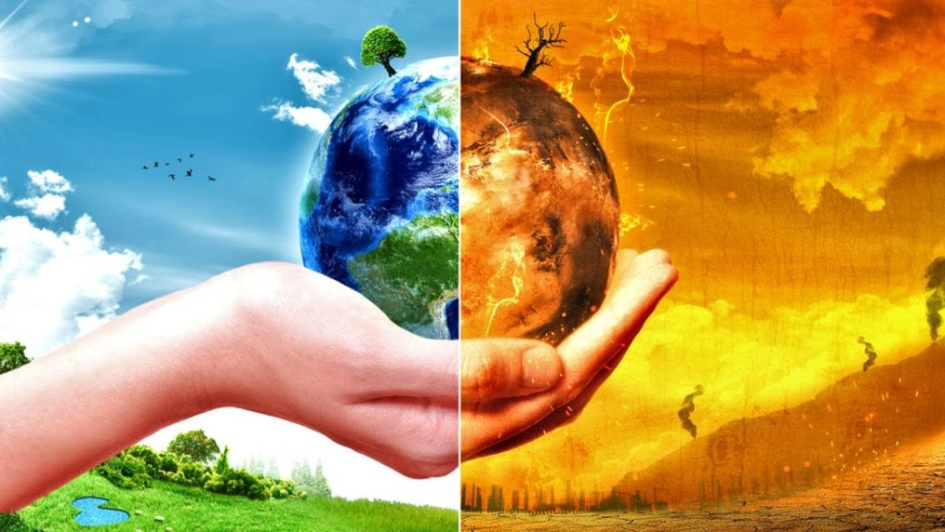
Global Warming
What feelings, thoughts, images and beliefs…
...come to your mind when you hear these two words?
Notes:
Activity: (3 minutes)
We hope to put some new thoughts/beliefs in your mind so we thought we’d start by getting out what is already there.
When you hear the words “global warming” what feelings, thoughts, images and beliefs come to your mind?
(Give them about 30 seconds and then open it up for very brief responses in the large group (popcorn style).

Slide 5
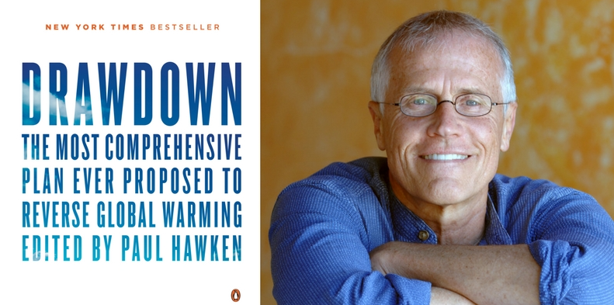

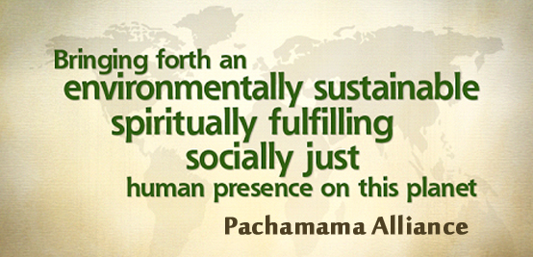
Paul Hawken
Founder of Project Drawdown
Notes:
(3 min – including video)
(CLICK ONCE) Let’s listen to Katharine Wilkinson, VP of Comm. and Engagement for Project Drawdown, describing what it is in much more detail.
(SECOND CLICK) To start the video playing

Slide 6
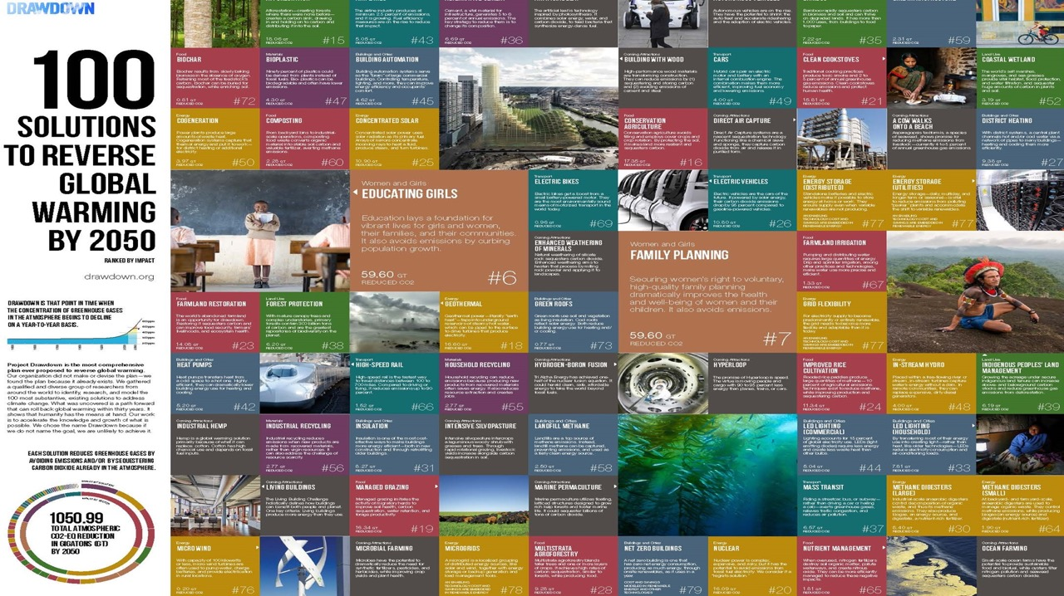
Notes:
1 min
Here is an amazing mosaic of the 100 Solutions to Reverse Global Warming by 2050 from Project Drawdown. We’ll go into more detail on many of these solutions shortly. But this gives you a sense/image of the broad scope of solutions being offered.

Slide 7

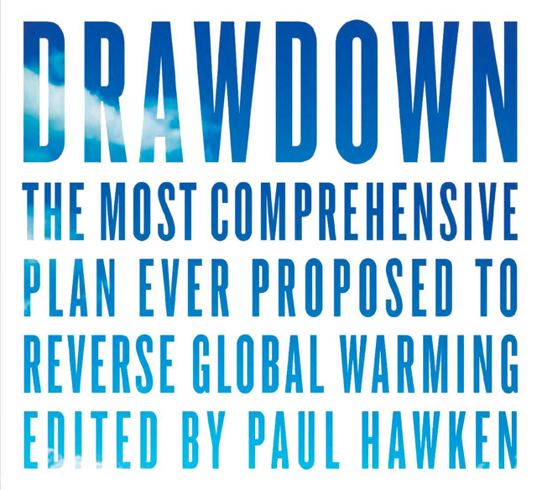
Notes:
Image of book – May 2017
The book that came out of this work, Drawdown, was published in April 2017 and was acknowledged as the Number One Best Selling Environmental Book of the Year.

Slide 8

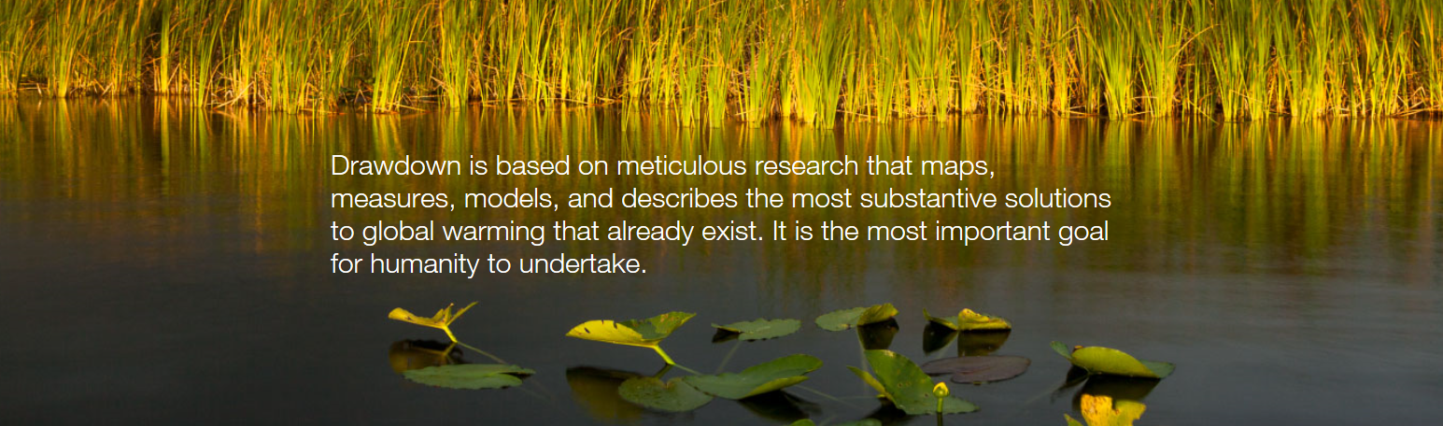
Drawdown Solutions Overview
Notes:
1 min
We will take a few minutes to look at some of the solutions, especially those that are relevant locally, but for now I wanted to just say a bit about what is covered in the book about each solution.
For every solution there are 2 pages, which detail the ranking, the amount of emissions reduced (usually in gigatons which is an unimaginable amount!), how the solution works (reducing emissions or sequestering carbon), where in the world it is being used, what the challenges faced for this solution, what are additional benefits, etc.
And if you check out the book at our Pachamama Alliance table – you’ll see some remarkably beautiful images throughout!

Slide 9
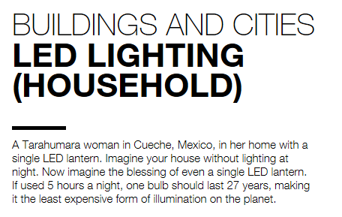
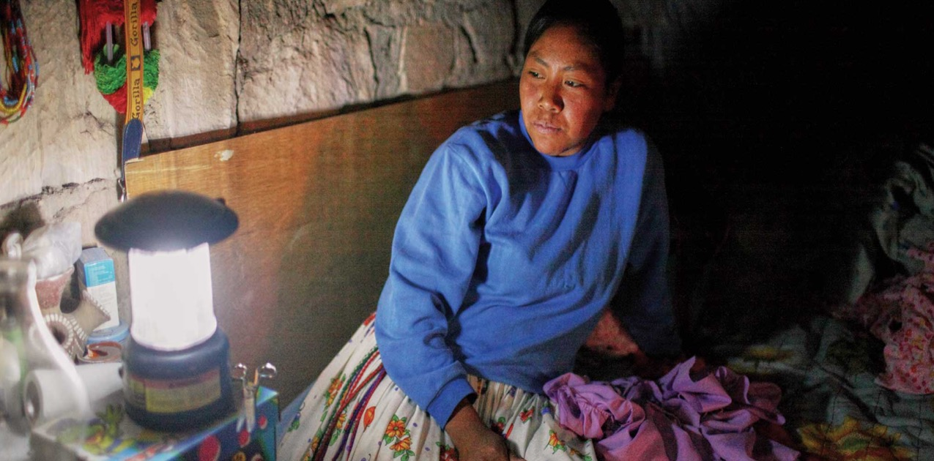
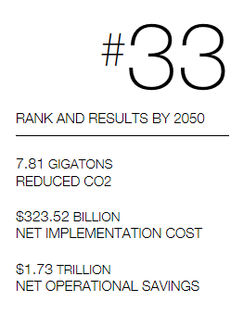
Notes:
For each solution the book lists its ranking in terms of impact in reducing carbon, how many much CO2 reduced (usually in gigatons), net cost of this solution, and net savings for this solution. Each section of the book includes description of the solution – history of the solution, how it works (less carbon emitted or sequestering carbon from the atmosphere), where it is being used, challenges with it, impacts of this solution, additional benefits, etc.
As we continue looking briefly at some of the solutions, we’re focusing, as participants have requested, on solutions that might be relevant to our area (since many solutions – like improved rice cultivation and tropical forests – would not be pertinent to our Rochester area). These following solutions are some being addressed locally by participants in our PA DD 4-session course. (we’ll talk more about that later)

Slide 10
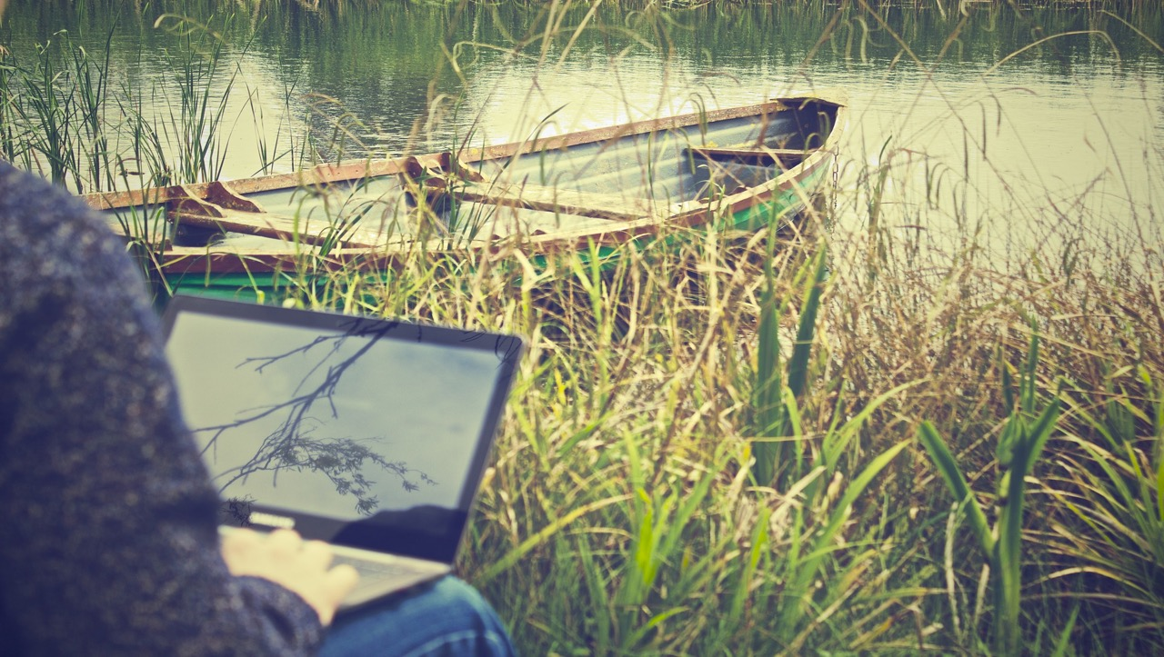
TELEPRESENCE
#63
1.99G
RANK BY 2050
REDUCED CO2
$127B
$1.31T
NET COST
NET SAVINGS
Notes:
#63 Telepresence (1 min)
And changing the way we work is also important. E.g. our local PA/DD groups are using zoom meeting more frequently.
Here is Telepresence, which is the 63rd ranked Solution. And take a look at these savings – $1.3 Trillion!
As you can see, this solution reduces carbon dioxide by 2 billion tons, which is certainly less than what we saw in the other examples, but there is no small Solution – we need them all! Every solution we undertake has a positive impact.

Slide 11
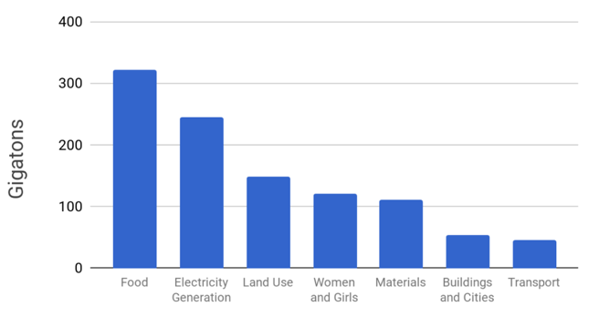
The Biggest Reductions Can Come from Food
Notes:
Out of the top 20 solutions, 8 directly relate to the Food sector, so the decisions we make every day on the food we produce, purchase, and consume is perhaps one of the single most important steps an individual can make.

Slide 12
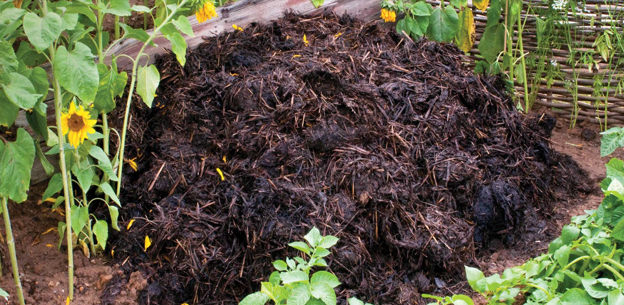

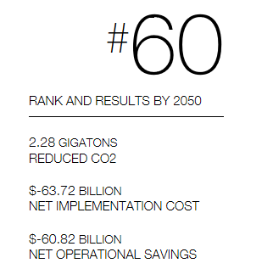
Notes:
Though #60 seems low on the list, as PH says, every solution is critical if we want to reverse global warming!
And many participants in our DD Course are learning about and taking action in their personal lives to reduce carbon in this way.

Slide 13
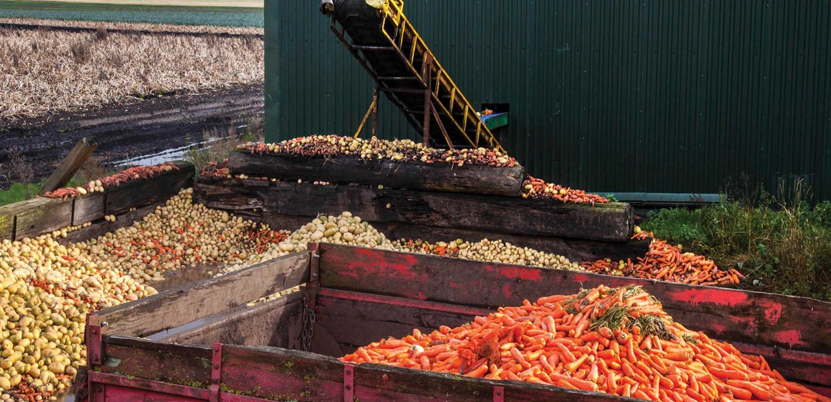
REDUCED
FOOD WASTE
#3
70.53G
RANK BY 2050
REDUCED CO2

Slide 14
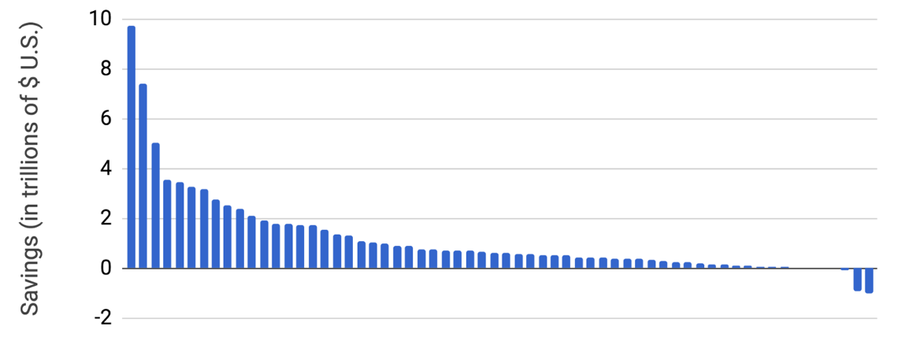
Together, the Drawdown Solutions Save $74 Trillion by 2050
“We also look at the net operating cost or savings from climate solutions compared to continuing business as usual. The net operating savings is $74 trillion over 30 years.” (DRAWDOWN – Pg. 220)
2020….…Net Operating COST (Savings) of ALL Drawdown Solutions Over 30 Years to.......2050
Notes:
Here’s one finding that really stands out: the net savings to the world of doing all these Solutions by 2050 would be 74 TRILLION dollars! Drawing down won’t cost us – it will save huge amounts of money!

Slide 15


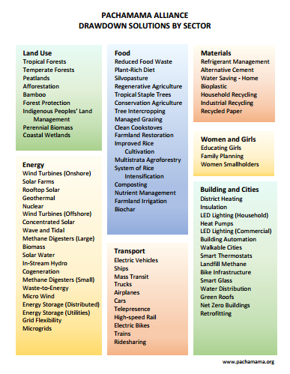


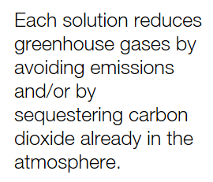
Notes:
On your table you will find a hand out - solutions by sector sheet (look at that side now, not the ranking) – they’re all important so we want to focus on the ones that speak to us – regardless of ranking!
This is a list of the 80 top solutions that PH and his team have documented as the most impactful in reversing GW. Notice the different sectors and wide variety of solutions. Something for everyone to engage in! Some of these solutions may be familiar to you and you may already be doing them. Some may be completely unfamiliar. This list is to stimulate your thinking, expand your sense of what is already happening, and invite you to consider how you might engage in action.
Pens on the table - Take just a moment to look at the list and put a check next to any you’re already engaged with in any way. Circle any you’re curious about and would like to learn more. And perhaps a star (or heart!) next to the ones that you’re passionate about and call you into action.
Depending on time – share at their tables – or popcorn style in large group. (probably no time if only 40 min)

Slide 16
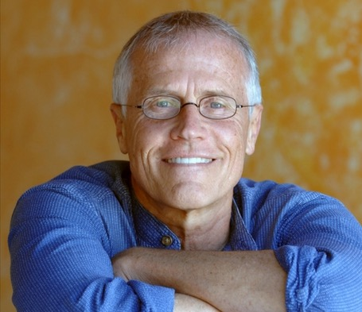
Completion:
It’s not up to Paul Hawken or the Pachamama Alliance.
It’s UP TO US !
Project Drawdown Interview with
Paul Hawken
---------------------
“Global Warming Solutions Solve Many Problems”
Notes:
Remember ---
It’s not up to Paul Hawken or the Pachamama Alliance or any other group, - it’s UP TO US! This is a global collective effort. All of these solutions ARE already happening. Each one of us can be part of making a real impact towards reversing Global Warming!
We’re all in this together as a human family, as part of the web of life on this beautiful earth.
GAME ON! (not Game OVER!)
Our purpose – mission in life – care for our earth and all life
On your table is another sheet with Ways to connect with the PA – locally and nationally/globally.
There are many transforming programs that you might consider checking out (e.g. ATD – 2 hour on-line course).
And if you go to our table and sign up, we’ll add you to our list for more information (other DD related documents that might interest you – like how to talk to people about GW) and/or our monthly Rochester PA newsletter – which is informative, uplifting and empowering! And it includes a Community Calendar with events from many local organizations!
****But what is most important to remember – this Drawdown effort is not just about solutions and what we DO. This work is really about WHO WE ARE – and how we relate to life, each other, the earth (Pachamama). This vision and work is grounded in our deep knowing that we and all life are connected.

Slide 17
In Summary: What Drawdown brings to the climate movement
It brings a plan.
An over-arching goal that can be a mobilizing framework for our climate actions.
1
It brings a positive message of hope.
The 80 existing, concrete solutions show what is possible right now!
2
It brings a focus on solutions, not on problems.
This frees people to take action & counters fear & denial.
3
It fosters collabor-ative and collective effort among individ-uals and organi-zations.
4
Notes:
(2 min)
Drawdown offers a coherent PLAN for action by everyone at every level of society around the world.
Drawdown also offers a message of hope. If we work together on these solutions we can reverse global warming.
The environmental movement has been focusing on problems for decades and this often paralyzes people or is so overwhelming that it feeds denial and stops people from being able to take action.
Drawdown is only possible if this is a collective effort – with each person, school, town, city, university, business, non-profit, library, etc. working on whatever solutions are within their reach.

Slide 18
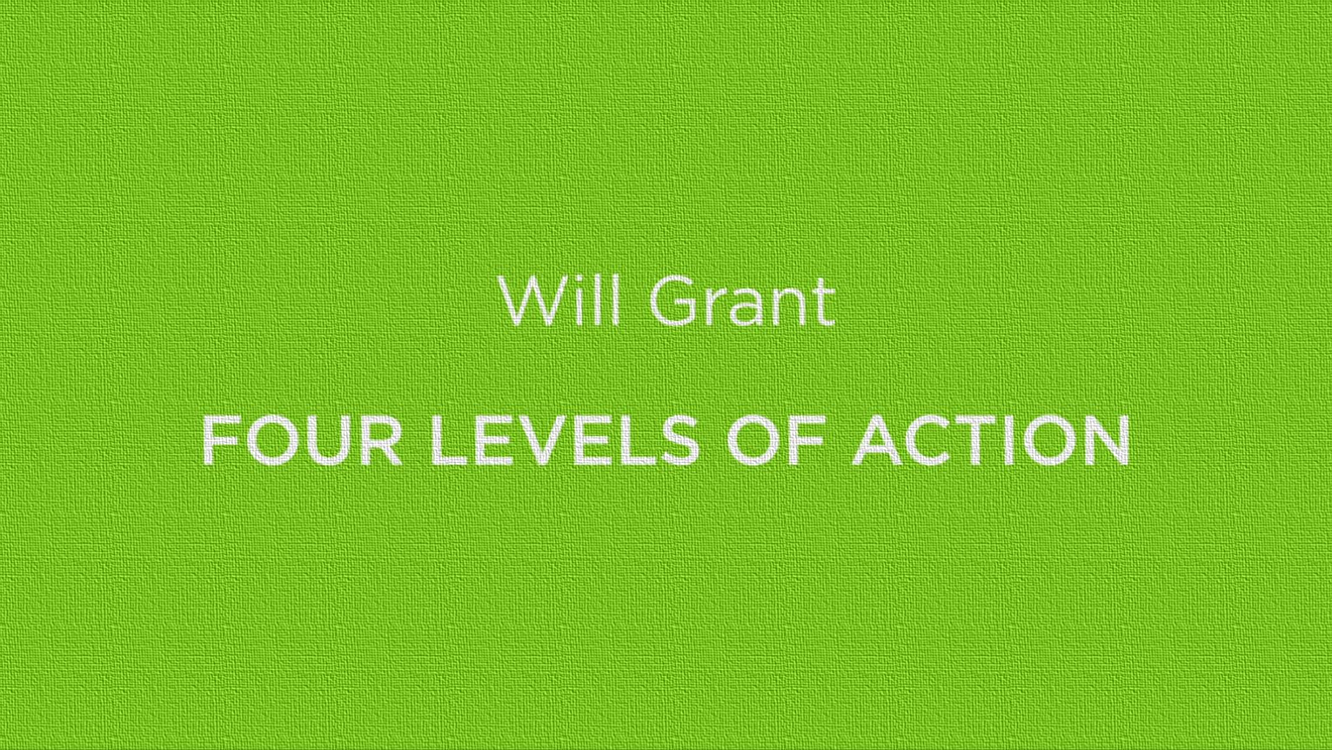
Individual
Family
Community/Local Institutions
Law/Policy Change/Economy
Abridged Version
Notes:
Will Grant – Four Levels of Action – ABRIDGED VERSION (4 Minutes 38 Seconds)

Slide 19
4 Levels of Action
Individual
Family
Community / Local Institutions
Law / Policy Change / Economy

Slide 20
What’s Next for You?
Learn more about Project Drawdown. (www.drawdown.org)
Get into action on a solution
Join the 4 session Pachamama Alliance Drawdown Solutions: Getting into Action Workshop.
Bring Drawdown to your communities.
Notes:
3 min
Ideas about what’s next for you may already have started bubbling up. Here are some suggestions:
1) Learn more on your own – go to www.drawdown.org and/or purchase the book or borrow it from your library. Continue educating yourself on these solutions and share this information and the real actions we can take as broadly as possible. For instance, have conversations with your family and friends. You may find this to be a very interesting experience! Also, there are books available to purchase out our PA table
Get into action on a solution – whatever interests you and is within your reach (e.g. composting, join an organization, etc)
The organizers of this event will be sending you a follow-up message, including a resources list that our Rochester DD group has created to give you help in finding information and resources (especially locally) to engage in solutions that interest you. Be watching for it!
3) If you’ve been inspired by what you’ve heard today, and want to delve deeper into this, we encourage you to join us in the next step, a 4 part Pachamama Alliance Drawdown Solutions: Getting into Action Workshop.(our next one starts Feb 14 (Valentine’s Day - no better way to love your loved ones and the earth!) – see flyers on your table for more information and a link to register) And we have 2 other Courses scheduled for the spring.
There is no charge for these programs, though donations are gratefully received.
In this 4 session workshop, we’ll have an opportunity to work together to move the Drawdown solutions into action! We will do research on some of the solutions, focus on what is already happening on these solutions in our local area, and then create an action plan for a project to move the solutions forward at our local level. Our hope is that you will be fully engaged in action, beyond the end of the 4 sessions together, and that you can collaborate with many others in this important work to help reverse global warming. Part of the intention is to encourage a sense of community among people drawn to this work.
Examples of projects in Rochester: Afforestation – planting trees (individually and with CBG, Genesee Land Trust), solar energy manual, fundraiser for RPCC, bringing issues to towns (CCA), food waste in schools, climate action plan, engaging with CCL, etc.), educating girls.
4) Bring Drawdown to your communities
It really is important to let as many people as possible know about these Drawdown Solutions and the excellent news that, working together, we have a shot at reversing global warming. Being a spokesperson to help shift the worldwide conversation around reversing global warming is vital and is something each of us can take on, whoever we are, whatever else we are doing.
Please also consider what local organizations, schools, businesses, institutions or even local political entities (such as your City Council) you may have access to, that might appreciate a program such as this one. At this time, many (if not most) have sustainability goals and commitments, and would welcome a program such as the one we’ve shared for their group. Let us know if you’d like us to come present this Introduction to Drawdown event to them – or if you’d like to be supported in presenting it yourself. This could be as simple as a gathering in your living room or in a Church or Community Center
The two-hour Introduction to Drawdown is about transforming how people think about the issue of global warming from one of hopelessness or fear to one of possibility and opportunity. Even mentioning this in everyday conversations can have an impact!
ANNOUNCEMENTS –
Upcoming events……………….
Invitation to Participate (if time and interest)

Slide 21

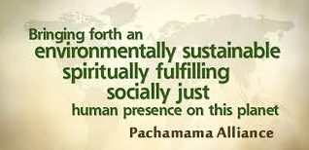
Completion:
It’s not up to Paul Hawken or the Pachamama Alliance.
It’s UP TO US !
Notes:
Remember ---
It’s not up to Paul Hawken or the Pachamama Alliance or any other group, - it’s UP TO US! This is a global collective effort. All of these solutions ARE already happening. Each one of us can be part of making a real impact towards reversing Global Warming!
We’re all in this together as a human family, as part of the web of life on this beautiful earth.
GAME ON! (not Game OVER!)
Our purpose – mission in life – care for our earth and all life
On your table is another sheet with Ways to connect with the PA – locally and nationally/globally.
There are many transforming programs that you might consider checking out (e.g. ATD – 2 hour on-line course).
And if you go to our table and sign up, we’ll add you to our list for more information (other DD related documents that might interest you – like how to talk to people about GW) and/or our monthly Rochester PA newsletter – which is informative, uplifting and empowering! And it includes a Community Calendar with events from many local organizations!
****But what is most important to remember – this Drawdown effort is not just about solutions and what we DO. This work is really about WHO WE ARE – and how we relate to life, each other, the earth (Pachamama). This vision and work is grounded in our deep knowing that we and all life are connected.

