Slide 1
Solving the Climate Challenge
Interfaith Climate Summit
May 19th, 2019
Notes:
Hello! I’m Rob Levine, I’m a volunteer with Citizens’ Climate Lobby.
Thank you to Cheryl Frank & Jim Tappon fo rputting this event together and inviting me and Hridesh here at the 1st Annual Interfaith Climate Summit.

Slide 2
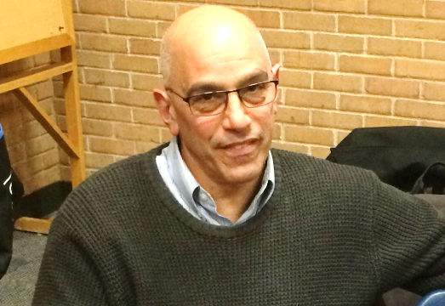
My Story
Rob Levine
CCL Volunteer
Soon to be grandfather and avid dog walker.
Notes:
I became involved with Climate Change about 4 years ago when the Paris Accords were being negotiated.
But I’ve worried about climate change for a lot longer.
I remember the very first Earth Day in 1970, and my assigned project in school was about the Great Barrier Reef. They predicted that ocean acidification would cause the coral to die off and those predictions made 48 years ago - have become startlingly true. We’ve known what would happen for a very long tme if we kept spewing pollution from fossil fuels.
So I decided, way too late in my life that I needed to do something because my children told me to either stop whining or get out and do something.
Now, 4 yrs. later, I have a grandchild on the way and it is more important to me now more than ever to be able to look that child in the eye and say that I tried to make a difference.
And I admit it ….my wife and I are ‘dog people’ – a very special breed - and our walks every day are important to us. Over the last few years the number of intense storms, and incredible heat and cold have affected our walks and the park near where we live, now floods on a regular basis.
I don’t believe it ever flooded the first 15 years we lived in the area, now several times a year.
And I believe it is our responsibility and obligation to do whatever necessary to keep the worst from happening
AND the good news it is possible. All we need to do is stop using fossil fuels.

Slide 3
Our Agenda
What do we already know about climate change?
Who is Citizens’ Climate Lobby and what solutions do they support?
What specific actions can you and I take to maintain a livable world?
Notes:
-----
That passion has led me here, to the Summit.
And I want to talk with you today about 2 of these 3 questions you see:
What do we already know about climate change?
Today we will pass on who Citizens’ Climate Lobby is but use our solution as an example.
And what specific actions you and I can take now to maintain a livable world.

Slide 4
Quick Poll
How familiar are you already with the facts and science of climate change?
1 ⇨ I haven’t the faintest idea
2
3 ⇨ I’m well-versed in the basics
4
5 ⇨ I’m totally up on this stuff
Notes:
OK quick poll.
Let’s get a sense of how you feel today in terms of understanding the facts and the science behind climate change?
Show of hands Raise fingers to identify yourself :.
1 is “I haven’t the faintest idea”, and 5 is “I’m totally up on this stuff and stay current.”
[Wait to see where everyone is and comment].
Great. Not many of you are atmospheric scientists, like me, but there is scientific consensus on basic ideas about climate change...so let’s review what we know.

Slide 5
What We Know
Scientists agree
It’s real
It’s bad
It’s us
And there’s hope.
Notes:
What We Know about our current situation can be summed up in 11 words:
Scientists agree (97% of climate scientists agree)
It’s real (polar ice melting, more intense storms and droughts, etc. are all telling us we have a real problem)
It’s bad need we say more?
It’s us (a quantifiable portion of climate change is human-caused)
And there’s hope. (we still have time though not much to fix this situation and slow the worst effects of manmade climate change).

Slide 6
How Long Do We Have?
The IPCC reports we have 11 years to cut global emissions by 50%.
Notes:
It’s not fun or easy to face the facts of what we are up against, but that is the first and the most important step we can take before you’re ready to act.
Scientists tell us we need to stop business as usual, because our current carbon consumption is leading us beyond a tolerable average temperature increase and a tipping point. A chain reaction we have no control over.
How long do we have to change the trend? The IPCC Report, the worldwide body of respected scientists who are experts at this stuff said in November that we have 12
years to change our carbon consumption patterns before the damage is so extensive that it’s impossible to reverse in our lifetimes or even our grandchildren’s lifetimes.
And the next 6 years are especially critical, because the longer we wait, the harder it is to make up for lost time. 6-12 years. That’s a very short time to tackle such a big problem.
**********************************************
https://www.carbonbrief.org/six-years-worth-of-current-emissions-would-blow-the-carbon-budget-for-1-5-degrees
https://www.cnn.com/2018/10/07/world/climate-change-new-ipcc-report-wxc/index.html

Slide 7
Quick Poll
This is mostly new information
I’ve heard most of this before
Notes:
Let’s pause and take a poll. Is this mostly new information to you or mostly old information? Raise hands for “new” or “old”...
So if we collectively already know this...what are we doing? How ready are we, as a society, to respond to this crisis situation? How ready are we in this room?

Slide 8
Which Describes You Best?
I haven’t heard much about climate change (or) I don’t think it’s much of a problem.
I think climate change is real and important, but I’m not yet doing much about it.
I’ve taken some steps to reduce my personal choices, but not much more.
I actively address climate change through my personal choices and by working for a national policy that lowers greenhouse gases.
1
2
3
4
Notes:
Here are 4 statements that describe a range of responses to climate change. Which describes you, as of today? There’s no right or wrong, or good or bad, there’s just an honest assessment of where you are now. Use the same 1 -4 finger method.
I haven’t heard much about climate change (or) I don’t believe it’s much of a problem.
I think climate change is real and important, but I’m not yet doing much about it.
I’ve taken some steps to reduce my personal / local carbon footprint, but not much more.
I’m actively addressing climate change through my personal choices and by working for a national policy that lowers greenhouse gases.

Slide 9
Question for Reflection
What’s the story I tell myself that keeps me from fully engaging around climate change?
In one sentence: “I….”
Notes:
Most of us are in #2 or #3, and that’s pretty typical. Recent attitude surveys show that more and more Americans “get it” in concept - outnumbering those who don’t by more than 5 to 1...and are not yet fully mobilized.
So let’s think more deeply about this. If most of us know the facts, and we agree climate change is important...what keeps us from fully engaging? Think about yourself, your friends and neighbors, your community leaders…
Honestly, there are all kinds of gaps between what I ideally want to do and what I actually do. So then I ask myself, what’s the story or thought that runs through me that keeps me from moving into action?
So please take a moment to consider: “What is the story I tell myself that keeps me from fully engaging around climate change?” Take a moment to really reflect, and see if you can express the core idea in one sentence, starting with “I”.
E.g., The story I tell myself is, “I don’t know enough.” or “I’m too busy” or “I can’t really do much about it” or whatever you notice you are telling yourself.
Turn to a partner, and just trade sentences, one after another. Go back and forth a few times. “What’s the story I tell myself that keeps me from fully engaging around climate change?”
Debrief: Let’s hear some of your thoughts, just one sentence please, starting with “I”
Do you hear any patterns? When I ask groups this question, I notice that their reasons for not engaging fall into 4 buckets:

Slide 10
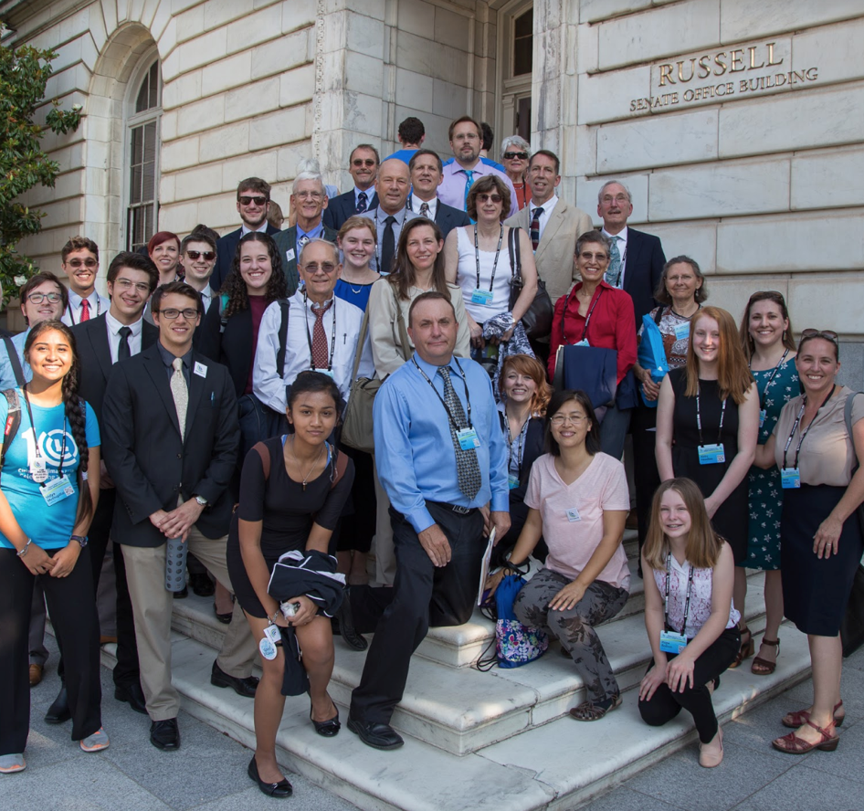
“Wait and See” vs. “Let’s Get Going”
Personal Conviction
Path to Success
Action Opportunities
Support
Notes:
So how can we get engaged in climate activity??
I think that moving from “wait and see” to “let’s get to work” depends on 4 factors.
Personal Conviction - I have enough knowledge and confidence so I can speak with others with sincere conviction
Path to success - I see a way to move from here to a successful solution
Playbook - I will take specific actions that will move us forward now
Support - I will work with partners or companions so we can encourage each other to keep moving forward
Which one of these, if it was supplied, would most get you and other people moving?

Slide 11
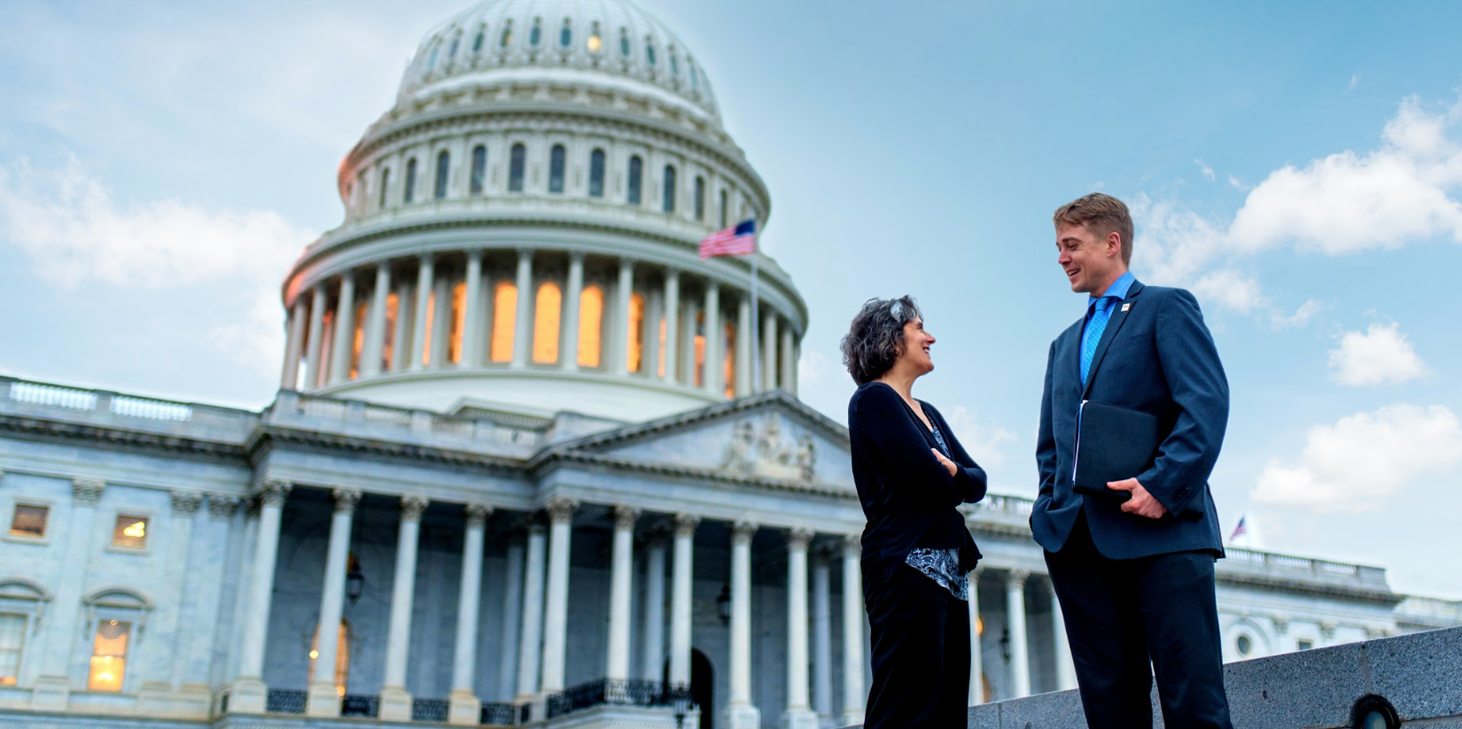
Build Political Will to Act on Climate
Notes:
So that’s why joining an organization can be key in getting involved in any activity like this.
Now, lets give you some other actions that you can do today, tomorrow whenever - that might help move you from a “wait and see” person to a “let’s get going” person.
First you need an objective and there is a solution called the Energy Innovation Act that CCL supports. That’s our focus. We’re going to need it as an example at times.
Our goal at CCL is to build political will to move Congress to enact legislation.
This solution is already gaining momentum on many fronts: Its called the Energy Innovation Act-in Congress now. Ready to go…
CCL volunteers are generating thousands of media articles and letters to the editor
Dozens of major organizations and leaders have signaled their support of this carbon fee and dividend legislation
Over 100 cities around the country have endorsed carbon fee and dividend policies including the City of Rochester and 7 surrounding towns and villages..
So it’s time for Congress to step up and pass legislation. And, that won’t happen without people like you and me adding our voices to the call for change.

Slide 12
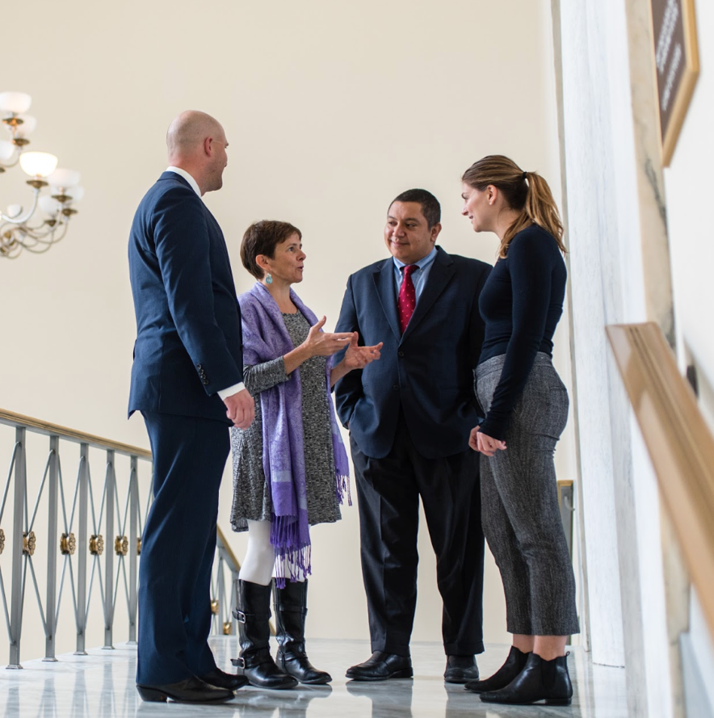
What’s Your Action Plan?
Continue to act locally
Share what you know about climate change
Advocate for an effective national policy
Notes:
So, lets pretend you agree that The Energy Innovation Act is a solution you can support.
What is your action plan? It’s really up to you to map out, but please consider two ways to take action.
First, continue to act locally.
Think about ways to act individually to look for ways to minimize your carbon footprint
One of your most powerful local actions is the simplest: Talk to your friends and neighbors about climate change. Share what you know, and ask them for their thoughts. We need to break the “spiral of silence” and help each other to speak up and take action...
Second is to advocate for national policies that will make a difference.

Slide 13
Actions We Can All Take
Grassroots Actions – Engage the Public at Large-
Grasstops Actions – Engage Business, Education, Municipal Leaders
Media –Write LTEs, Op-Eds, Radio, ***Social Media!!
Lobby - call on Members of Congress to Act NOW
Notes:
So what can you do to start your climate warrior career? Whatever your objective be it to save your local creeks and streams or enacting national legislation these actions can be effective.
We’ll talk about Grassroots Actions , Grasstops Actions, Using Media and Lobbying

Slide 14
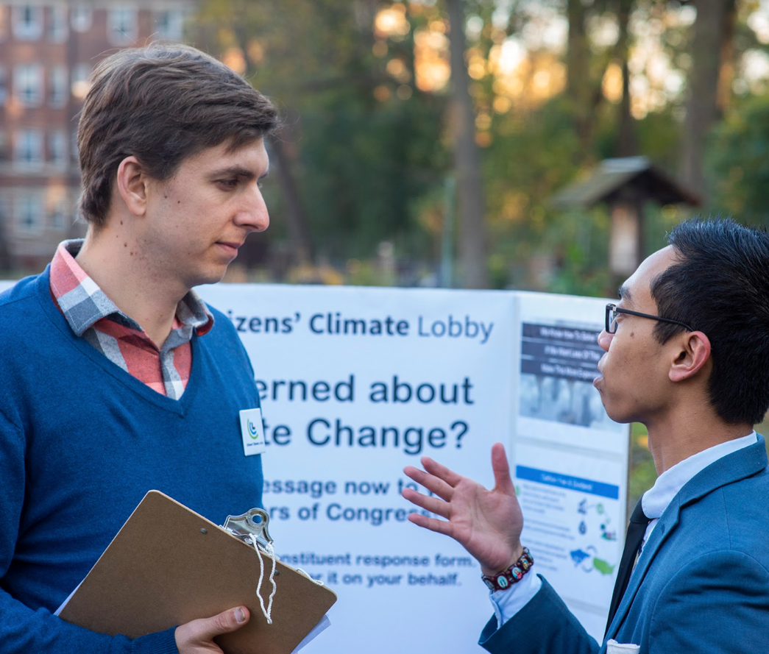
Grassroots Outreach
CCL volunteers engaged in 3,072 outreach events in their community in 2018.
Tabling at markets, Summits & events
Film Screenings
CCL Climate Meet-ups
Notes:
So what are some steps we can take? Well at CCL we practice several levers of influence that we believe will help us get The Energy Innovation Act passed by Congress.
So again -consider joining a local organization. You could engage with your local CCL chapter ( we have TONS to do !) or any organization that shares your values.
One thing we do is Grassroots outreach. We are a grassroots all volunteer army of over 140,000 members! The value of the support one gets from working with a group of like minded people can not be underestimated.
Tabling - Ask people to sign postcards and petitions, or sign up to learn more about your organization.
Our Chapter “tables” at local events from art fairs to Church Summits, at Earth Day events and during Pride Week, we team up for movie nights with groups like we did here not long ago. Plus neighborhood events, rallys….
Total number of CCL outreach events in 2018, 3072

Slide 15
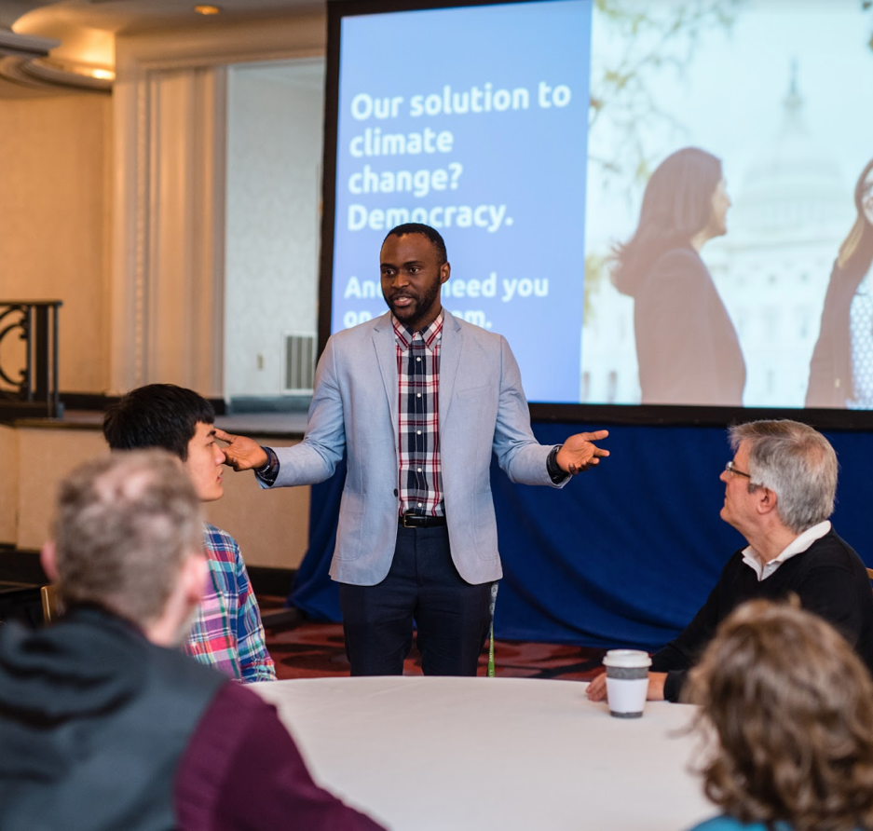
Grasstops Engagement Local Leaders
CCL volunteers tallied 3,675 endorsements for climate action .
Who do you know who might endorse your approach?
Business leaders, Faith Leaders,
Municipal and Education Leaders
Bring CCL to speak to your groups and organizations
Notes:
Another lever of action we pursue is Grasstops Outreach:
You could open doors for CCL to speak to local groups and organizations. Learn to speak yourself.
Total number of endorsements, of all types, through the end of 2018, 3675
Who do you know who might want to endorse this legislation? Think of people who can help influence our MOCs?
Just who are Grasstops:
Business Leaders, Faith Leaders, Municipal Leaders – Mayors and Supervisors, Higher Ed. Leaders like Univ Presidents, Celebrities, Athletes

Slide 16
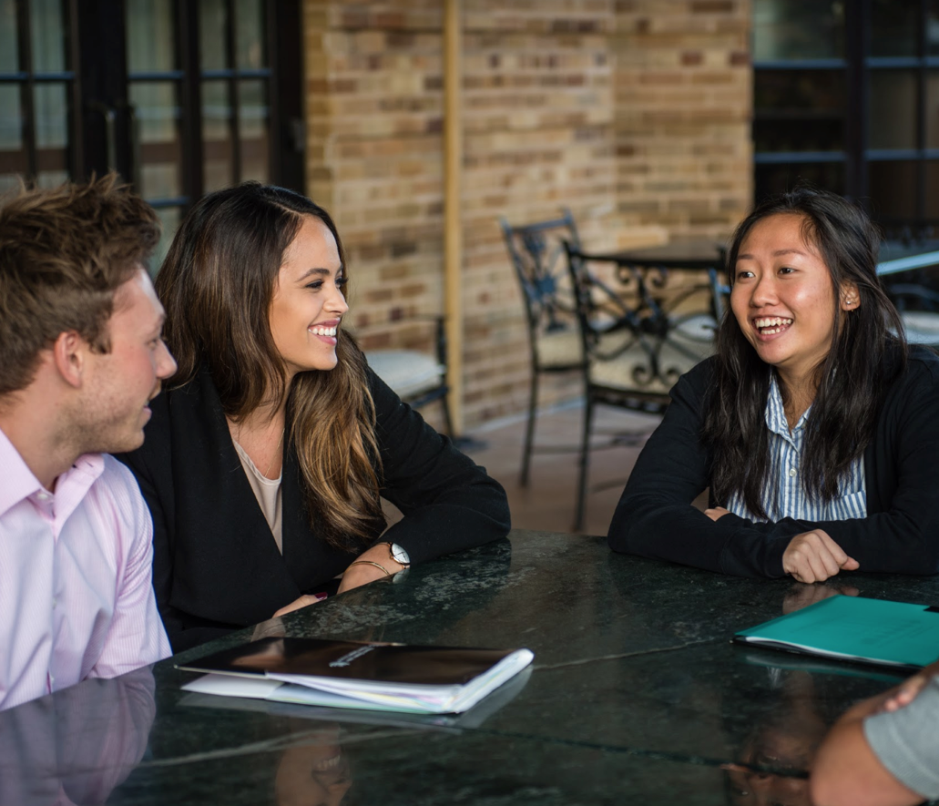
Use the Media Effectively
Letter writing Op-Eds, LTEs
Essays
Host letter writing parties
Follow us online: Facebook, Twitter,
Instagram, YouTube
Notes:
Media outreach
LTE, Op-ed pieces, social media
Facebook, Twitter, Instagram, YouTube and iTunes
4,173 letters and op-eds CCL volunteers published in 2018.
Are any of you on Social media?
Use these #s:
#BipartisanClimate
#PriceonPollution
#KeepRochesterCool
#GrassrootsClimate
#
#

Slide 17
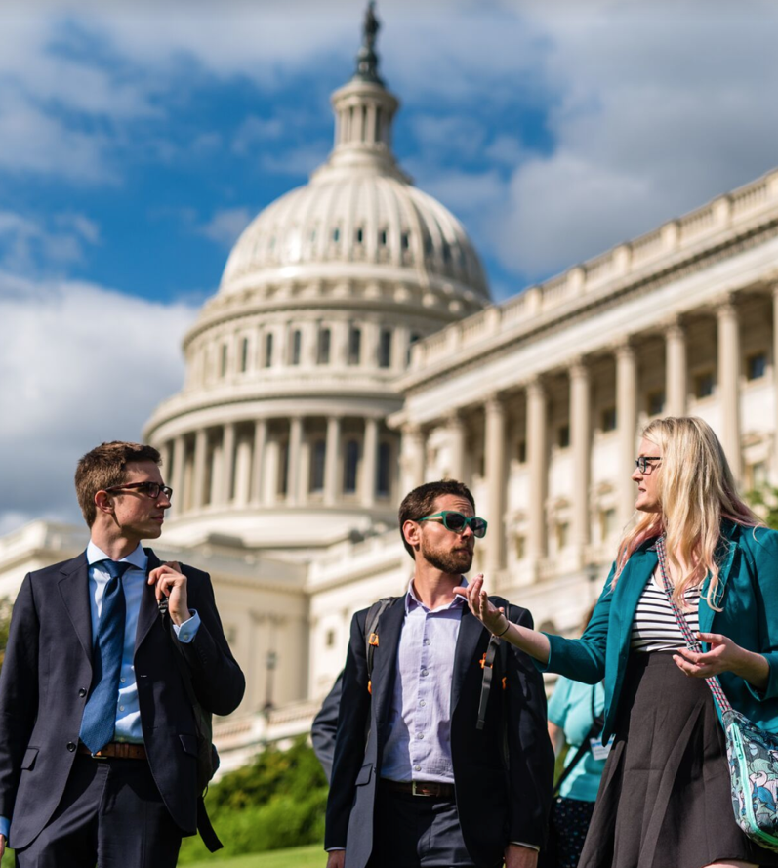
Lobby: Join Our Next Visit To Congress!
CCL volunteers held 1,398 meetings with members of Congress and staff in 2018.
Join in-district visits with your Members of Congress
Come to our annual Conference & Lobby Day, June 9 - 11th, 2019 in Washington, DC: cclusa.org/conference
Notes:
Join our meetings with Congress
In-district / your MoC
National conference / Lobby Day - Swarm the Hill in June 2019 - it will change your life!
All of this information and more is available in the hand-out at your tables…
Volunteer Opportunities Hand-out: https://community.citizensclimatelobby.org/take-action/start-a-local-group/volunteer-opportunities-handout/

Slide 18
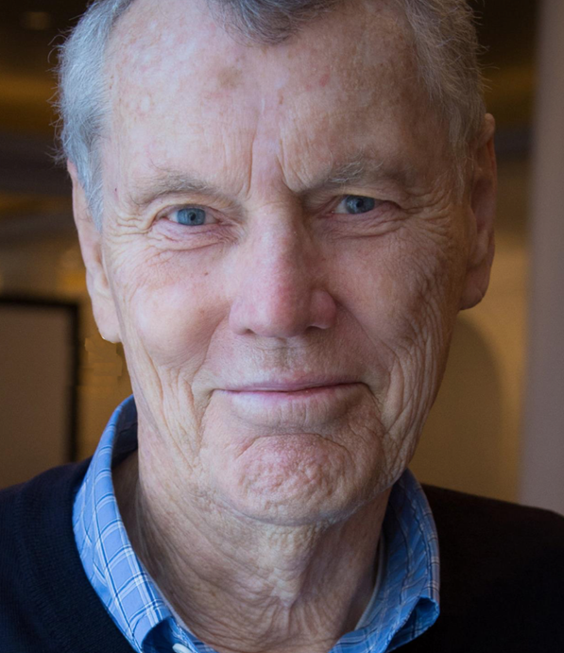
I used to think that the important people were taking care of the important problems.
No. Preserving a livable world is up to us little people. What we do and do not do really counts.
Marshall Saunders, CCL Founder
Notes:
This is Marshall Saunders, the founder of CCL. Marshall always makes a great case for what it means to be an engaged and active citizen.
I used to think that the important people were taking care of the important problems. I don’t think that anymore. Preserving a livable world is up to us little people. What you and I do and do not do has a profound effect upon the world. What we do and do not do counts.
--------------------
Additional Context
CCE’s founder Marshall Saunders’ aha moment was when he realized that “Ordinary people like you and me have to organize, educate ourselves, give up our hopelessness and powerlessness, and gain the skills to be effective with our government.”
We are truly blessed to live in a country where citizen engagement is valued and encouraged. As citizens, it’s not only our right but our duty to be engaged and to express our voice.
Remember politicians don’t create political will, they respond to it.
“
Maybe just maybe, that is true for us more than any other group in history. It may sound arrogant, it may be arrogant, but I think it’s true. Life asks for our full self-expression. What underlies our willingness to be fully expressed, to risk ourselves, to act outside of our comfort zone, is love. Love for ourselves, love for each other, love for those who would oppose us, and love for all life.”

Slide 19
Questions??
What did you learn (or re-learn) today that is important or energizing?
What actions will you take?
Local action
CCL / national policy action
What questions do you have?
Notes:
Pairs: Discuss with a neighbor
What did you learn (or re-learn) today that is important or energizing?
What actions are you ready to take locally? For a national policy?
What questions do you have? After we regroup -we’ll make sure to save some time for them.

Slide 20
Thank You!
Rob Levine
E-mail: badger2217@gmail.com
Phone: 585.752.9690
Chapter: Rochester Chapter CCL

