Slide 1
Rochester Area Climate Action (RAICA)
Composting at your House of Worship

Slide 2
Who we are:
Mission:
We are an inclusive group of individuals and communities of faith.
We connect, coordinate and collaborate to provide a meaningful response to climate change and sustainable living.
In doing so we acknowledge our common conviction to work together to care for the earth and its people.
Vision:
To inspire, connect and empower Rochester Area individuals and communities of faith to be active agents of change and beacons of sustainability, living in harmony with our planet.

Slide 3
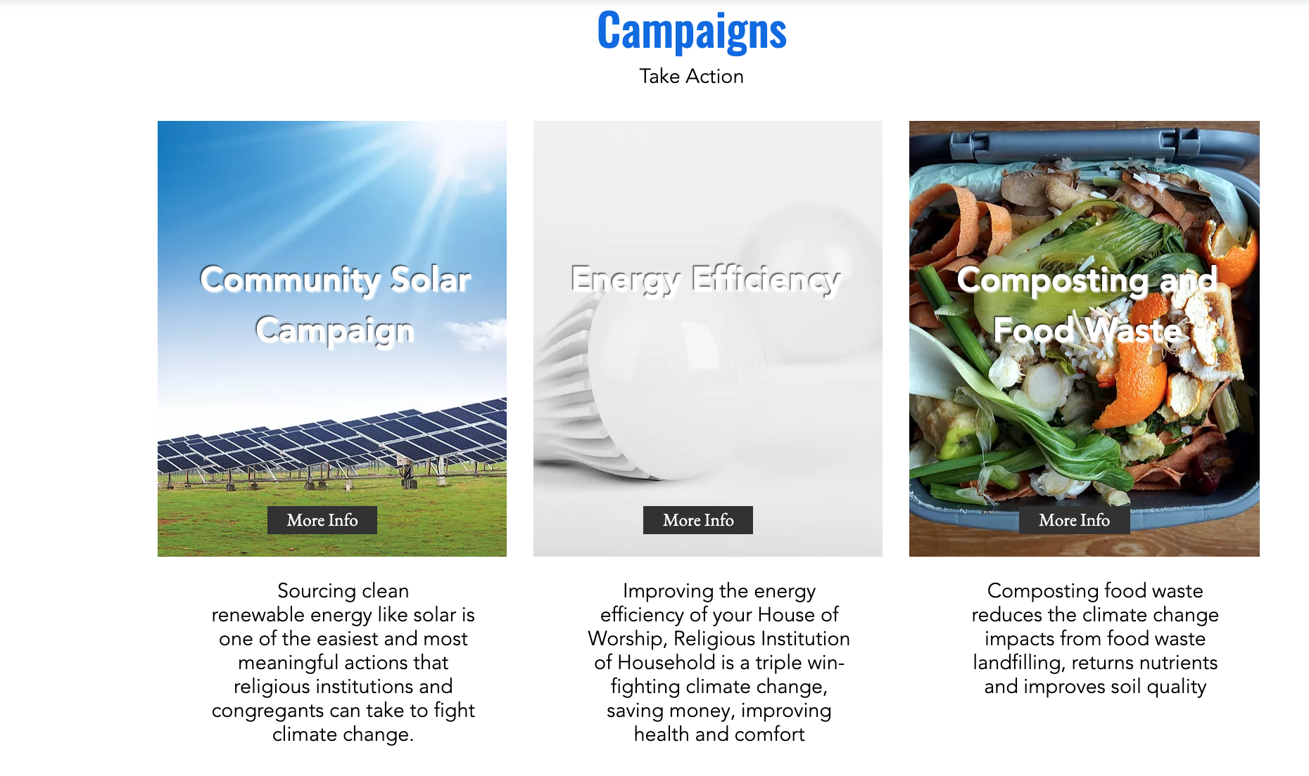
RAICA.net

Slide 4
Why is composting important
Food waste that decays in a landfill generates methane which is a greenhouse gas (GHG) approximately 30X more powerful than CO₂.
Landfill emissions make up more than half of the state’s methane emissions and are the largest source of non-fossil fuel related emissions (although only about 5% of the State’s total GHG emissions).
Compost has additional benefits including enriching and restoring soil health, reducing fertilizer use and improving soil water retention

Slide 5
RAICA and Impact Earth
RAICA has partnered with local Organic Waste Hauler ImpactEarth to provide commercial composting and compost “bucket exchange programs” to Houses of Worship/Institutions in the Rochester Area

Slide 6
RAICA and Impact Earth- Commercial Hauling
For Houses of Worship with commercial kitchens or larger amounts of food waste
Several different sizes of toters are available ranging from 32 gal. to 96gal.*
Begin with once a week pick up
then assess usage and adjust as needed
Contact ImpactEarth for pricing
Impact Earth Commercial Pricing Sheet
*Additional local options are available for large commercial or industrial food waste hauling services

Slide 7
RAICA and Impact Earth- “Bucket Exchange”
How it works:
Subscribers receive an air-tight bucket to collect household food waste and compostables
See list of Impact Earth Accepted Materials
Subscribers bring their full buckets to their House of Worship or another exchange location on designated days to swap it for a clean one
Coordinate with Impact Earth for a time and location at your House of Worship
Requires a minimum of 12 subscribers
Space for two pallets (about 5ft X 12ft. )
Drop off and pick up of pallets on same day
Community drop-off locations also available (see website www.Impactearthroc.com/services)

Slide 8
ImpactEarth
Bucket Exchange video link
Notes:
Note you must be in slideshow mode for this link to automatically open

Slide 9
On-site Composting
Information and support for setting up a compost system can be obtained at Cornell Cooperative Extension (http://monroe.cce.cornell.edu/horticulture/compost-resources)
Options include:
Outdoor Composting
Simple composting structures can be easily constructed from chicken wire or wood.
Commercial bins can also be purchased.
Indoor Composting
Worm bins can be constructed or purchased to compost in your garage, basement or under your kitchen counter.

Slide 10
Managing the investment in a commercial composting service
Having a Composting services at your House of Worship but …
It will reduce your volume of landfill waste so keep track as you may be able to downsize to a smaller container and a lower hauling fee
Paying for organics hauling may provide an incentive to reduce food waste
Sending food waste to a landfill generates external costs that are born by all of us (including those related to climate change). Paying for composting is paying our fair share and investing in our future.
There may be options to finance the investment
Donations
Often there are members that feel strongly about supporting composting that may be able to fund the initial costs
Cross-subsidizing from other programs
Other RIACA’s campaigns may generate savings (e.g. Energy Efficiency) or donations (e.g. Community Solar) that can be applied to fund a composting service
Apply for a grant
Opportunities may exist through faith organizations, the NYDEC or other organizations. (RAICA may be able to help you pursue these.)

